Slide 1
The birth of the human sciences
Harry Oosterhuis

Slide 2
How, where and why did the notion of human science emerge?
How did the rise of human science relate to the Scientific Revolution: similarity/continuity and differences/ruptures?
What is the relation between the rise of the human sciences and the Enlightenment?
Where can de rise of the human sciences be located: in which intellectual fields and in which national contexts (France, Britain and Germany)?
What is, in the view of Foucault, the relation between the rise of the human sciences and the idea of the panopticon, introduced by Jeremy Bentham?

Slide 3
Scientific Revolution→Science of Man
Secular view and rational explanation of the world.
First attempt to position man in nature and understand man in material terms (Hobbes).
New image of man: Christian-Aristotelean concept of the soul → the secular view of man as a being with a (rational) mind and a (mechanic) body (Descartes) and the notion of the human being as an individual subject with an inner self (Locke).
New epistemologies on the basis of subject – object dichotomy: deductive rationalism and inductive empiricism.

Slide 4
Scientific Revolution → Enlightenment
Not only external nature, but also ‘human nature’ as an object of rational scrutiny. → Understanding mankind not in relation to God, the scriptures, magical beliefs and inherited tradition, but to nature, society and history. → Not only external nature is ruled by laws, but also ‘human nature’ is conditioned by patterns and regularities.
Continuation and intensification of the shift towards a secular and an empirical and more or less materialist view of human beings.
Just as scientific knowledge of external nature can be used to control nature and develop technology in order to master nature, scientific knowledge of man is relevant in a practical way: health, self-control, well-organized life, social conduct, civil society and state, political relations and ethical standards.

Slide 5
David Hume: Treatise of Human Nature (1739):
His plea for the study of man can be situated on the threshold of the Scientific Revolution and 18th-century developments.
The idea of a science of man (‘moral sciences’) modeled on Newton’s explanation of nature and John Locke’s empirical approach.
Hume’s epistemology: our common-sense experience of the world as orderly, familiar and largely predictable, is not an inherent quality of the world itself, but the result of how the human mind processes our experiences and how these processes involve the formation of habits and routines that advance a perception of reality as if it is stable and self-evident.
Explaining ‘human nature’ through systematic empirical investigation of man’s practical ways and habits, routines and conditioned responses to external influences in relation to his physical make-up and passions.
Using such knowledge as a guidance for man how to conduct his life on a rationally informed basis.

Slide 6
Differences and discontinuities:
Scientific Revolution: The emerging notion the model of the of ‘human nature’ and natural sciences the science of man in the 18th century
The endeavor to establish a scientific study of man in the 18th century built on the ambitions of the 17th-century Scientific Revolution, but at the same time it distanced itself from the Cartesian and Newtonian natural scientific model.

Slide 7
The human sciences and ‘human nature’: 3 complications
Man as subject as well as an object of knowledge
‘Human nature’: fact ←→ value naturalist
’is’ ←→ ‘ought’ fallacy
naturalist ←→ culturalist view of man
determinist ←→ voluntarist view of man

Slide 8
Natural ←→ Human sciences: Different relation between subject and object of knowledge
Natural sciences: subject ←→ object
the conscious and thinking scientist ←→ blind and indifferent external nature (objects do not respond or comment )
Human sciences: man as a thinking, explaining, acting and responding being is subject and object of research and knowledge at the same time. → Swift’s story about Gulliver in the land of Giants: Gulliver exposed as the object of scientific observation by giant scholars, but at the same time he comments on their speculations.
What is done in the human sciences - reflecting on and explaining what human beings are and do - is also done in daily life and common sense.
Knowledge in the human sciences cannot be separated from common-sense self-reflection and self-understanding in daily life and from responses to such knowledge in society. (The only difference: in science this is done in a more rational, systematic and controlled way.)

Slide 9
Fact and value: ’is’ versus ‘ought’
Overlap of subject and object of knowledge in the human sciences → the difficulty to separate facts and values, notions about what man is and should be, what we really are and how we wish to see and shape ourselves.
Whatever the validity of their empirical data and evidence, scientists ask questions and understand their ‘facts’ from the perspective not only of certain theoretical approaches, but also of broader moral, religious, social and political notions about the meaning of being human, which imply value-judgements.
Scientific knowledge about ‘human nature’ is influenced and shaped by the current meanings and value-judgements in the social and cultural environment in which it produced.

Slide 10
Are the human sciences part of the natural sciences or not → Are they part of the ‘cultural sciences’?
Views of ‘human nature’
Naturalist Humanist or ‘culturalist’
human nature as human nature as the product of
given by biology social and cultural meanings
Explanations of ‘human nature’
Deterministic Voluntarist

Slide 11
Two historical legacies of the human sciences: Humanism (humanities) ←→ Scientism (natural science)
The humanist or ‘culturalist’ self-image of man: human beings as basically sovereign, self-conscious, active and rational subjects, in control of their faculties, in charge of their actions and being able to direct their own fate.
Renaissance and Enlightenment: the view of man as a superior and exceptional being because of his unique ability to reason, to act as a conscious and responsible agent and to explain and dominate the world. Voluntarist perspective: man’s history is one of liberation and emancipation from the constraints of nature.
The positivist, scientist, naturalist view: like other living creatures, man is part of nature and determined by natural laws, conditioned by his biological make-up or his living-environment.
Scientific Revolution and Enlightenment: man can be studied as a being who is part of nature, determined by natural laws, cannot escape the forces of a blind and indifferent nature.
The ambivalence of the Enlightenment

Slide 12
‘Human nature’: meaning not self-evident → essentially contested concept
The key concept in the human and biomedical sciences is problematic → ‘nature’ is not given but always defined by human beings in a cultural context: it is open to diverse, possibly disputed definitions and value-judgments.
‘Human nature’ can refer to what man supposedly is and what (s)he should be: mixture of scientific ‘facts’ and sociocultural, ethical and political values and objectives. → The naturalist fallacy: the confusion between and conflation of empirical facts of nature and moral, political and ideological values: the projection of what is considered morally, socially and politically desirable, in a supposedly given natural essence and potential.
‘Human nature’ used to promote specific social, cultural, religious or political claims about what man should be. → In the light of such claims ‘nature’ always seems to be on one’s side, just like people of different religious creeds tend to believe that God is on their side. (Enlightened proponents of human rights as well as the Nazi’s used their particular notions about ‘human nature’ to underpin their claims and policies).
Referring to ‘nature’ as a basis for moral and political claims and social interventions is so attractive because of the suggestion that they are underpinned by the authority of ‘objective’ scientific knowledge and that further political or ethical debate can be ruled out.

Slide 13
What is scientific knowledge of man about?
Do the human sciences uncover the reality of an essential, given nature of man that is part of nature in general?
Or is scientific knowledge about man not more than a reflection of how humans have interpreted, given meaning to their ‘nature’ in the context of particular historical and sociocultural settings and how man has been (re)shaped by sociocultural meanings including scientific notions? → →Theories of human nature may not be true as a reflection of an underlying reality but rather have their own way of becoming true if people adopt such knowledge in order to understand themselves.
Roger Smith: The human sciences and their history cannot answer the question what the essence of ‘human nature’ is, but they can only show and elucidate the wide variety of socially, culturally and scientifically molded interpretations and meanings of human nature, which on their turn can have the effect of further (re)shaping ‘human nature’ in multiple ways.

Slide 14
18th-century meanings of ‘human nature’
1. The ‘primitive’ condition of man apart from society, culture and history:
comparing Western man with man in other ‘uncivilized’ parts of the world;
contrasting the ‘state of nature’ (Hobbes, Locke, Rousseau) and ‘artificial’/‘contractual’ society;
detecting irrationality and ‘wildness’ among Western populations (‘our inner Africa’): insanity, criminality, violence, sexuality, lack of education, pauperism, childhood.
2. The concrete human body and the processes of life including their influence on the mind which became the object of biology and physiology (assignment 2).
3. Natural law thinking → abstract notion of what all men have in common: reason and the inherent capacity to develop and use this faculty (Descartes, Locke → emancipatory imperative of the Enlightenment, see Immanuel Kant).

Slide 15
Scientific Revolution→Science of Man: 18th-century epistemological shifts
rationalist → empiricist epistemology
general, universal truths → interest in the particular and human diversity
changing view of man:
mind-body dualism → mind increasingly associated with and drawn into the body;
man as a psychosomatic, sensuous being

Slide 16
Rationalist → Empiricist epistemology
Formal, abstract, deductive reasoning, quantification and mathematical logic.
Locke, Berkeley, Hume
Observation, perception, sensual experience, description, systematic comparison.
Swift’s story about Gulliver in the land of Giants: Gulliver exposed as the object of detailed scientific observation by giant scholars.
The model of the panopticon designed by Jeremy Bentham: individuals continuously observed; man as the object of an all-seeing scientific gaze.

Slide 17
English Empiricism (John Locke, David Hume, George Berkeley)
Apart from reason, the (physical) senses as source of knowledge: without input from the external world, reason is empty and helpless → Locke: the mind of a new-born child is a tabula rasa and is filled through sensual experience and learning → man, body as well as mental and moral make-up, shaped by the physical and socio-cultural environment.
Human beings born with a mind including inherent rational capacities to process sensual experiences, but the substantive contents, the building-blocks of the mind (impressions →‘ideas’ and ‘associations’ between different ideas) are the result of the experiences of the outside world.

Slide 18
French Sensualism (De Condillac, Helvétius, d’Holbach)
Radicalisation of Lockean empiricism:
Not only the contents of the mind (impressions, ideas, associations, thoughts, and also feelings), but also mental faculties (perception, knowledge, understanding, judgement and memory) and self-consciousness itself are the products of experience and depend on the senses (seeing, hearing, touching feeling, smelling, tasting).
The crucial role of the (physical) senses as the mediators between what is in our mind and the external world: without sensual (physical) experience there would be nothing in the mind at all.
The mind considered as being closely related to and even dependent on the body.
Descartes: self-consciousness generated by autonomous self-reflection; inner self strictly separated from the material world, gains certain knowledge on the basis on pure logical reasoning.

Slide 19
Empiricism/sensualism: man is malleable
Human beings can be shaped and improved by organizing the environment, enlightenment, instruction, upbringing, education, conditioning and habit-formation.
Flexible ‘nurture’ rather than ‘nature’ → rising interest in education of children (assignment 5).
Underlying notion of human nature: a shared rational mind and the capacity to develop the mind → voluntarist and culturalist belief in the possibility of equality and social harmony.

Slide 20
Empricism/sensualism: secular and utilitarian ethics
Feelings and ideas about what was right or wrong connected to experiences of pleasure and pain. → Good and evil associated with physical and mental experiences instead of divine or metaphysical imperatives. → utilitarian egoïsm?
Locke: the relation between the experience of pain and pleasure and moral behavior is not direct, but mediated by rational thinking which can control and regulate feelings of pain and pleasure so that possibly egoistic behavior can be channeled into orderly social behavior based on self-control and accountability. → The crucial role of socialization: the development of the rational faculties and responsibility through education and a stimulating environment.

Slide 21
General, universal truths → interest in the particular and human diversity
Attention for differences between individuals as well as groups of people and comparing them:
Interest in other, non-Western and ‘primitive’ cultures → native/Western culture is put in perspective and questioned.
Interest in ‘the Other’ in the Western world, people who are different, in particular those who appear to be irrational, such as the insane (‘normal’ versus ‘abnormal’).
New fields of research (physical anthropology, craniometry, physiognomy, phrenology, as well as racial ethnography): the systematic measurement, description and comparison of physical differences among individuals, the sexes and other groups of people. → Empirical method + underlying scientist notion of ‘human nature’: nature as destiny (biological determinism).

Slide 22
Physical anthropology Craniometry

Slide 23
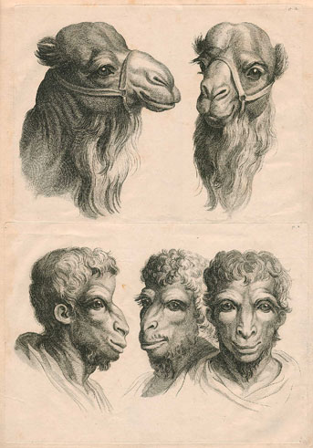
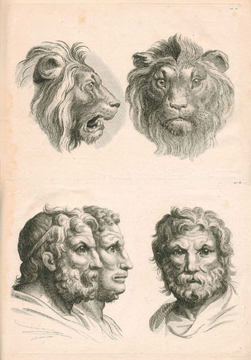
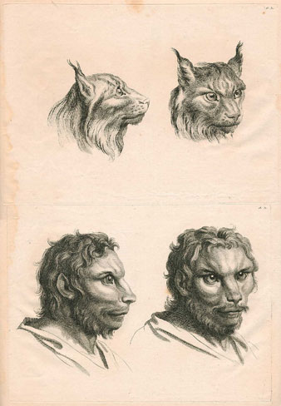
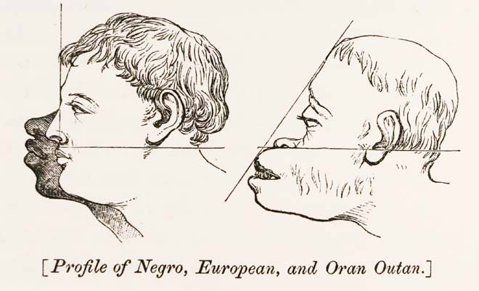
Physiognomy

Slide 24
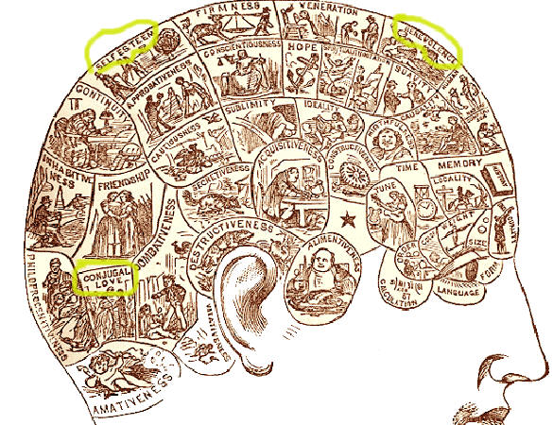
Phrenology

Slide 25
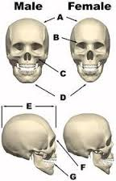
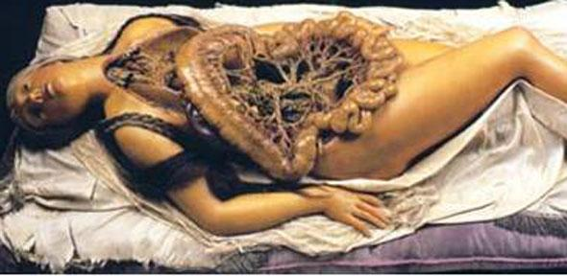
The gendered body

Slide 26
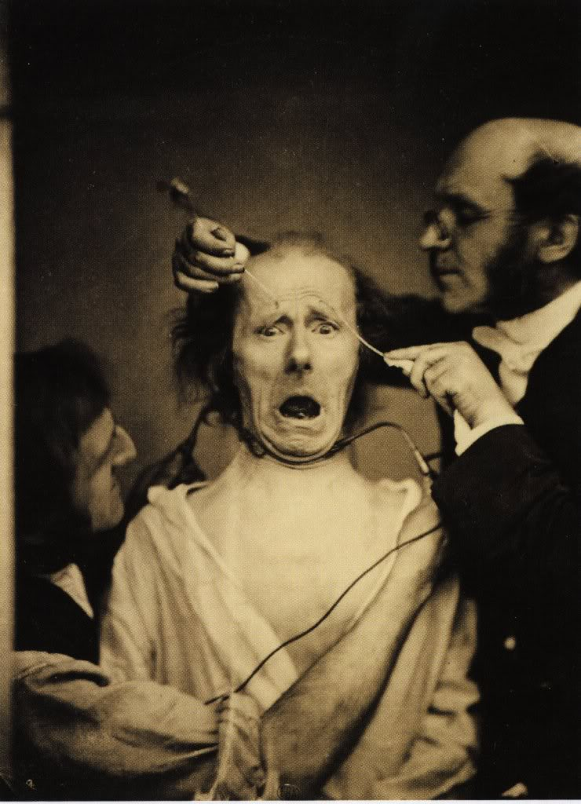
Madness, wildness, ‘our inner Africa’ →psychiatry

Slide 27
Body-mind dualism→ holistic/psychosomatic view of man
Descartes:
mind is immaterial/metaphysical phenomenon outside/above the rest of nature
the body is like a machine that can be explained in mechanical terms
‘Holistic’/’psychosomatic’ perspective on man in empiricist/sensualist philosophy and medical-physiological research:
Close connection between the body as a sensitive organism and the ‘moral’ part of man (thinking, feeling and social behavior).
Mind naturalized: increasingly associated with the working of the body, more and more drawn into the body and ‘de-centralized’ (Moravia) → man as a psychosomatic, sensuous being (focus on the senses and nervous system as the link between body and mental processes).
Vitalist explanations of life in medicine and biology → assignment 2.

Slide 28
‘Anthropology’ as a new field of knowledge
The comprehensive study by physicians, physiologists, educators and philosophers of man’s physical as well as ‘moral’ (mental, behavioral, sociocultural) nature, of how man was determined by inborn traits and the environment.
Anthropology → in the course of the 19th century differentiation in disciplines: biology, experimental physiology, natural scientific medicine, psychology, psychiatry, neurology, criminology, ethnology/cultural anthropology and sociology.

Slide 29
The human sciences in Germany: self-development and ‘Bildung’
Bourgeois identity: the importance of self-reflection and rational conduct for a self-controlled life.
‘Anthropology’ as a practical guide for life in civil society (Immanuel Kant) → personal autonomy and intellectual and cultural shaping of the self (Wilhelm von Humbold: Bildung).
Popularization of anthropological knowledge:
‘Psychological’ discourse in popular-scientific publications.
Investigating individual character → interest in physiognomy (Lavater) and frenology (Gall & Spurzheim).
Growing popularity of autobiographies and novels describing the inner life of characters → (Romantic) values of personal sincerity and authenticity.

Slide 30
The human sciences in France: The Revolution and the ‘Ideologues’
‘Ideological’ project during French Revolution and Napoleontic era: establishing comprehensive empirical science of man based on sensualist philosophy and broad medical knowledge → Basic assumption: Health and good life depend on interaction between constitution, habits and living-conditions.
Applying scientific knowledge about man → Improving personal and social life through rational education and social hygiene; a rational organisation of society (reform proposals in the field of education, medicine, justice, poor relief, and the care of the insane and social hygiene); establishing models for sensible (democratic) citizenship.
Sociopolitical background: the turmoil of the French Revolution and the Napoleonic era → Worries about social disintegration → Broadly-felt need for a new view of man that was geared to ground-breaking sociopolitical change and could include differences between individuals and groups, while simultaneously establish an objective and neutral standard for modern individual and social life → Balancing the instability of and discord in politics and democracy by firm and unbiased scientific expertise.

Slide 31
The human sciences in Britain: The Industrial Revolution
Social-economic modernisation: the need for social reform geared to a rational and efficient organisation of industrial society → emphasis on productivity and utility.
Jeremy Bentham and ‘Philosophical Radicals’ (James/John Stuart Mill, Ricardo, Chadwick): reform of society on the basis of scientific knowledge about man and society, and inspired by an empiricist-sensualist view of man → Strong belief in the malleability of man: man should be shaped and improved on the basis of education, legislation, the organisation of the environment, social-scientific knowledge (statistical registration: making society transparant) and systematic surveillance (Bentham’s panopticon).
Scientific knowledge about man as a secular and practical guideline for ethics and social policy → Utilitarianism.

Slide 32
Bentham: Utilitarianism
The principal human drive is hedonistic and egoistic: the avoidance of pain and discomfort and the striving after pleasure and happiness.
The need to bend the basically hedonistic and egoistic nature of man into a beneficent, social and moral direction by establishing not individual but collective happiness as a moral standard → the principle of ‘the greatest happiness of the greatest number’ as the measure of right and wrong → the moral quality of an human act depends on the amount of happiness which it adds to the total amount of happiness → individual self-interest and the common good harmonized; the promotion of the public interest would eventually benefit all individuals.
Realizing the greatest happiness of the greatest number on the basis of Bentham’s ‘hedonistic calculus’ → efficient utility, a rational measure for right and wrong, as the dominant moral principle in social engineering and planning.
Reform-proposals in the field of law, health and disease, social policy, poverty relief, education and the fight against crime → Social technologies in order to make society transparent and surveyable:
Statistical registration of the population and the economy;
The Panopticon.

Slide 33
Bentham’s panopticon
Architectural model for prisons, poor houses, work houses, factories, mental asylums, hospitals, schools and the army.
Historical background: increasing institutional segregation of groups considered as a nuisance in modern industrial and urban society because they did not meet the requirements of productivity, rationality and efficiency.
New institutions: poor- and workhouses for the poor, the unemployed and tramps; prisons and reformatories for criminals and vagabonds; asylums for the insane and the handicapped; and hospitals for the ill.
Objective: re-socialization and bringing back problem groups to reasonableness and productivity through a strictly regulated institutional environment and a regime of systematic observation, classification, experimentation, inspection and surveillance for different purposes → confining suspects, punishing/correcting criminals, guarding/treating the insane, reforming the vicious, employing the idle, treating the sick, preventing the spread of epidemic diseases, educating children, instructing/disciplining laborers and soldiers.
→ Ultimate goal: Internalization of the surveying gaze → self-regulation.

Slide 34
Social and political context of the rise of the human sciences
The rise of the middle class: knowledge of ‘human nature’ serves the cause of shaping a bourgeois identity and the realisation of liberal values: self-determination, self-development, self-regulation, self-control.
Democratic freedom and equality, entailing discord and instability, have to be balanced by scientific control and social engineering based on expertise and professional knowledge of ‘human nature’ → technocratic governance.
Resolving problems of industrializing and urbanizing society and the requirements of the capitalist economy (productivity, efficiency, labour discipline) → social management.
The growing significance of utilitarian ethical and social thinking: determining the greatest happiness of the greatest number → tackling social problems and finding a practical balance between individual interests and the common good.

Slide 35
Foucault: Discipline and Punish
Foucault: panopticon was the model for the modern prison and penal regime.
Historical background of his analysis: rationalization and ‘humanisation’ of penal justice from the late 18th on:
Traditional penal regime: retaliation, corporal punishments in public as a spectacle to set an example. Crime was seen as a direct and personal attack on the authority of a ruler and on a divine order. Guilt had to be confessed (parallel with confession of sin in the Church), if necessary through torture.
Enlightened legal thinking: harsh punishments are ‘barbaric’, arbitrary and ineffective. A more rational, transparent, fair and humane penal system geared to re-education, rehabilitation and reintegration in society.
In the first half of the 19th century physical punishments, including the death-penalty, increasingly replaced by detention in prisons in which prisoners were subjected to a disciplinary regime in order to reform them, reflecting the enlightened meliorist approach of man.

Slide 36
Foucault’s view on the rise of the human sciences
The arrangements, strategies and techniques which have been used to shape the modern prison-regime are typical of the way how the human sciences systematically developed knowledge about man and contributed to the disciplining and normalization of modern man in an increasingly (formally) equalized and democratized society.
The Panopticon was the quintessential machinery for the connection of knowledge to power, the surveillance and control of individuals and the disciplining of bodies and minds.

Slide 37
Foucault’s view ←→ common-sense notions about the rise of the human sciences and the design of man:
That the human sciences were producing unbiased and neutral knowledge about man and that the language in which this knowledge was expressed was mirroring some sort of underlying truth or reality about man.
That scientists first discovered scientific knowledge about man and that such knowledge was subsequently applied in society.
That this knowledge served Enlightened purposes and values such as progress, emancipation, and liberation.

Slide 38
Foucault about power and knowledge
Knowledge generated by the human sciences and the language to formulate it (discourse) was intrinsically linked to certain social practices involving power. → Scientific knowledge developed in panoptic institutions which segregated problem groups and controlled them through registration, categorization, observation, surveillance, verification, comparison, correction and behavioral regulation.
The purpose of panoptic regimes: to delineate the normal and the abnormal and to establish a normal standard for the general population.
‘True’ knowledge about man did not so much precede the panoptic regimes, but it was produced through its material conditions, the applied social techniques and discursive practices, and the ongoing mutual reinforcement of knowledge, power and discipline → Continuing systematization and refinement of the disciplinary techniques in order to make them even more efficient and effective and to gain even more detailed knowledge about individuals and particular groups.

Slide 39
Disciplinary society and liberal democracy
How does the disciplinary surveillance regime fit in with the development of liberal democracy since the French Revolution? → normalization and control increasingly internalized: ruling individuals not by an external power from above, but through transparency, self-regulation and self-improvement.
The need to normalize individuals and make them internalise certain values became greater the more a society was democratised → When hierarchy and external pressure are ‘not done’ any more (because democracy implies equality and rights), inner motivation, self-control and self-regulation are all the more crucial to maintain a stable social order.
A democracy, in which the state cannot regularly use violence and force to compel obedience and orderly conduct, can only be stable when it relies on the consent of individual citizens who are self-responsible, in control of themselves and behave in a more or less regular, self-directed and predictable way. → Dovetailing with the Enlightenment ideal of emancipation: people should take responsibility over their personal and social being along rational lines in order to establish a stable social and political order.
If individuals do not adapt to the new social order, they should be encouraged to do so: the need to be open for interventions aimed at improvement → Force and coercion replaced by interventions in the name of rationality, science, progress, efficiency, self-improvement and ‘for your own benefit’ and ‘getting the best out of yourself’.

