Slide 1
Historical Origins of the Human Sciences
Harry Oosterhuis

Slide 2
The development of scientific knowledge about man since the late 18th century
Perspective:
History and sociology of science (Cultures of Knowledge and Technology: contextual understanding of knowledge and its practical application).
How scientific knowledge of man is related to practical efforts (either successful or not) to influence, control, change, (re)shape, improve or enhance man.
Part of the project of modernity since Scientific Revolution and Enlightenment: science and (material and social) technologies as means to control, plan and improve nature, society and man.
Traditional attitude: human life determined by nature, fate, divine providence or unquestioned habits and customs.

Slide 3
Scientific knowledge about man analysed at 3 levels
Underlying philosophical and cultural assumptions of what man is or should be.
Context: institutional, social, political, cultural and economic factors.
Practical application in society.

Slide 4
1. Culturally embedded views and self-images of man
Christian view of man versus secularized image of man.
Enlightened versus Romantic views of man as a rational or emotional creature.
Different views and metaphors with regard on the actual workings of body and mind:
working of the human body and mind compared to machines and explained in mechanical terms;
holistic representation of man as an organism.
Basic presuppositions about nature of man closely related to philosophical debates on how life, human consciousness and behavior are best explained, how basic questions about man are answered.
→ What is life?
→ What is the relationship between life and matter?
→ What is the relationship between life and the human mind; between animal life and human life; between body and mind, between body/mind and behavior?

Slide 5
2. Context
Institutional settings in which scientists operate (modern universities, research institutes and facilities, laboratories and modern hospitals).
Formation of separate scientific disciplines and processes of professionalization (scientific claims of expertise, specialized practices, the interests and strategies of professionals to advance their field and their own position in the scientific world as well as in society at large).
Broader social, cultural, political and economic factors:
secularization and rationalization;
the rise of the modern administrative state intervening in ever more areas of human life;
democratization, industrialization and urbanization, which gave rise to new social problems for which solutions had to be found and new forms of administration and management were required.

Slide 6
Reciprocal relation between human sciences and society
Contextual factors → human sciences:
how social relationships, cultural meanings and ideolo­gies have influenced and framed knowledge (questions, theories and methods) of scientists and professionals.
Human sciences → society:
how scientific knowledge and methods were applied in order to intervene in society and thus shaped the experience of individual self and social relations.

Slide 7
3. Practical application of scientific knowledge about man
To what extent and in what way is scientific knowledge of man related to the endeavor to change and enhance human beings?
What are the social conditions and implications of the application of knowledge of man?
Who applies such knowledge and which perspectives social backgrounds and interests are involved?
What are the intended and unintended effects in society?
Where do its boundaries lie, in a practical as well as in a political and ethical sense? → Should what is possible also be permissible?

Slide 8
Sociological and historical perspectives
Michel Foucault: knowledge – discipline/power; normalization, ‘biopolitics’ and ‘biopower’.
Civilisation theory of Norbert Elias: relation between changing regimes of social control and changing experiences of the self.
Modern risk society (Anthony Giddens and Ulrich Beck): how modern society deals with uncertainty and dangers → role of science to control uncertainty.
‘Life-politics’ (Niklas Rose and Zygmunt Bauman): how people use expert knowledge in the organisation of their lives entailing increasing reflexivity (reciprocal shaping of knowledge and social practices).
Political and social democratization (individual self-determination and assertiveness of lay-people, patients, clients) and relation to (scientific and professional expertise (exclusive knowledge and skills; in itself not democratic).
Discipline-formation and professionalization: how scientists and experts organize themselves, promote their interests and social relevance, establish knowledge-claims and expertise, and gain social influence.

Slide 9
How scientific disciplines are made through ‘boundary-work’
Boundaries between scientific disciplines which study (aspects of) man, are not self-evident and do not reflect an objective order or boundaries existing in nature.
Organization and division of knowledge of man into scientific (‘objective’ and verified) versus non-scientific (philosophy, religion or daily/practical) and various disciplinary fields (including academic departments, training-schemes, professional organizations, journals) is contingent and changing, of a historical nature.
Demarcation and construction of disciplinary boundaries on the basis of various criteria:
object of research (body, mind, human behavior, culture);
epistemological views, methods of research, styles of reasoning, and explanatory models and analogies;
competition and disputes between scientists and their professional, strategic and social interests; their claiming of territory and expertise against each other.

Slide 10
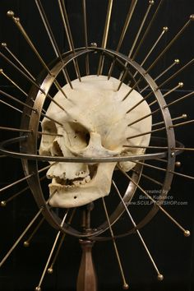
‘Pre-history’ of the Human Sciences and the Changing Image of Man

Slide 11
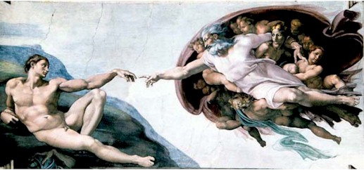
Changing self-image of man: secularisation/naturalisation + individualisation
Religious and metaphysical + Communitarian/Collectivist
16th/17th century:
- Renaissance/Humanism
- Reformation
Modernization
17th/18th century:
- Scientific Revolution
- Descartes’ view of the self
- Locke’s view of the self
- Social-economic developments
- Natural Law → liberalism
Secular and naturalist + Individualized and personalized

Slide 12
Traditional image of man:
rooted in collective social organization and in Christianity.
Individualized and secular view of modern man emerging in Renaissance and Scientific Revolution, and coming to full development in Enlightenment.

Slide 13
Traditional communitarian way of life ruled out individualism
Most people imbedded and submerged in collective and hierarchical social bonds of dependence and obligation → members/representatives of collective entities: families, kinship groups, clans, village communities, feudal estates, corporative organizations, guilds etc.
Independent existence and consciousness as an individual was hardly possible.

Slide 14
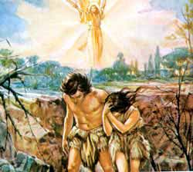
Christian view of man
Man situated in and subordinated
to a God-given, eternal moral order:
Paradise → the Fall → temporary and life on earth →
→ Christ the Savior → last judgement.
Moral judgment in terms of virtue and sin: living according to God’s commands was the crucial guide in life.
Man’s destiny and meaning of life not in this life on earth, but in one’s fate after death, eternal life in heaven or damnation in hell.
Ambiguity:
Since God has banned Adam and Eve man from paradise, man is a fallen creature, burdened by original sin and therefore imperfect.
Man endowed with an immortal soul and gifted with reason and free will providing the ground for salvation.

Slide 15
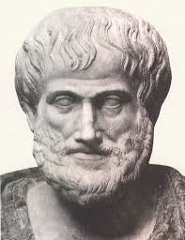
Aristotelian roots of Christian conception of the soul
Soul as essence of man determining human purpose:
Soul as the ‘form’, organizing principle of body, spiritual force which cannot exist independently of matter, implying that the soul is at least partly situated in the body.
Teleological worldview: everything has inherent natural purpose in a ordered and meaningful universe: man embedded in the Great Chain of Being (parallel of the macro- and microcosm) → Final cause of human beings found in divine origin and supernatural destiny of their soul.

Slide 16
Aristotelian/Christian soul different from modern idea of mind as separate from and as opposite to body
Two dimensions of the soul (natural and supernatural):
organic life force (and as such related to body and shared with other living creatures);
immaterial spirit (intellectual faculties of reason, judgement and free will) making man superior to rest of nature and immortal.
No strict boundary between two dimensions (natural and supernatural): soul as subject for theology as well as philosophy and medicine.
No separation between religion and rational knowledge = recognizing and understanding God-given order of the world and man’s position in it (Great Chain of Being).

Slide 17
Renaissance, Protestantism, Scientific Revolution, Enlightenment
16th-18th century: two crucial changes in self-image of man:
Secularization:
Man as rational being who can more or less control own destiny on earth; rational faculties enable improvement.
Knowledge about man distanced/separated from metaphysical and religious thinking enabling man as object of rational analysis and empirical investigation.
Individualism:
Development of experience of subjective, self-conscious self as autonomous entity, implying separation of secular inner self from disenchanted external world.
Emergent idea of individual as unique and authentic ‘personality’ (in particular since Romanticism).

Slide 18
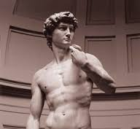
Renaissance
Humanistic learning: rediscovery of Greek and Latin philosophy advancing intellectual reflection about man and his qualities and capacities → shifting emphasis from divine supernatural order and imperfection of fallen man to recognition of secular dignity of man: man as measure of at least worldly things and belief in man’s ability to take earthly fate in own hands.
Secularized and practical moral philosophy marking a turn away from hereafter to here and now → civic humanism:
(upper-class) ideal of self-improvement through education, arts and cultivated manners, serving aspiration of political, commercial and learned elites;
gathering realistic self-knowledge in order to fashion character, self-control and self-responsibility: qualities needed for economic calculation and ruling common people. (Machiavelli’s advice to rulers and medical and didactic guides for leading healthy and successful and elegant life.)

Slide 19
Medicine as guide for the good life
Ideal of humanistic self-knowledge and self-mastery not only relevant for the mind, but also for healthy and vigorous body → importance of medicine, not only for treating illness, but also as practical guidance for leading a good = healthy life through keeping a sound balance between the organic and spiritual part of the soul → Medicine together with moral philosophy playing a crucial role in origin of human science:
Morality and health both defined in terms of maintaining balance and harmony between passions and well-considered behavior/self-control.

Slide 20
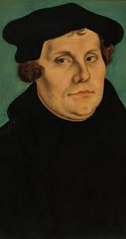
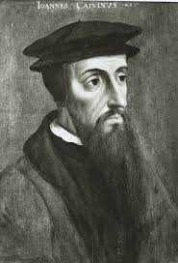
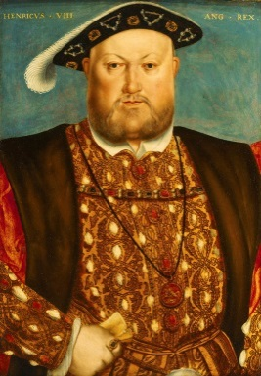
Protestantism
1517: Luther→ Lutheranism
1530s: Calvin→ Calvinism
1530s: Henry VIII → Anglicanism
Rejection of unquestioned authority of clergy and of magical elements of Catholicism (church rituals such as mass, sacraments and confession, indulgences (buying off sins), adoration of Maria and saints, and belief in miracles) → disenchantment.
Believers reading (translated) Bible for themselves (‘priesthood of all believers’) → Internalization and individualization of faith: emphasis on personal conscience, inner motivation and individual responsibility.
Direct relation between believer and God without intermediate authority of the clergy → individual thrown back upon him/herself → inner self-reflection → Protestant philosophers introducing term psychologica for thinking about one’s self.

Slide 21
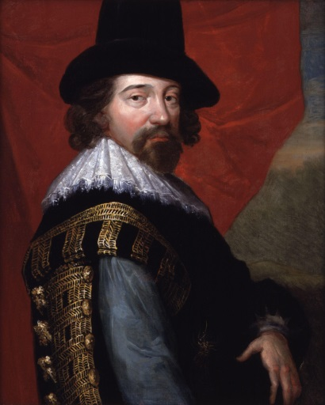
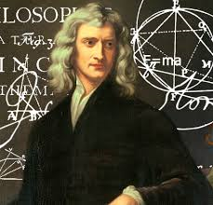
Scientific Revolution
Rise of ‘natural philosophy’ (→ natural science): nature as external and autonomous reality created by almighty God (‘great watchmaker’), but proceeding and working according to its own mechanical laws without direct divine intervention.
Proof for God’s existence not found in revelation and miracles, but in harmonious natural order working in regular and predictable fashion and explained in mechanical terms (impersonal causes and effects):
Disenchanted nature without inherent meaningful purpose
Bacon Newton
Aristotelian universe full
of meaning and ultimate purposes

Slide 22
Teleological → materialist-mechanical explanation of the world
Modern natural science excluded Aristotelian teleology (inherent final causes).
Materialist-determinist view of nature without intrinsic meaning: nature studied in terms of purposeless material particles in motion without inherent direction, but uniform and regular according to mechanical operation of cause and effect, which could be measured and calculated in quantitative, mathematical way. → Explaining the world was not any more the recognition and clarification of its inherent purposeful meaning, but discovering its regularity through experiment and calculating its mechanical predictability.

Slide 23
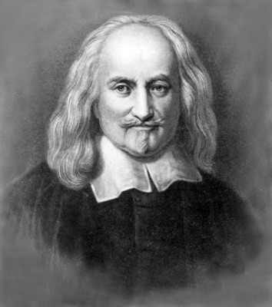
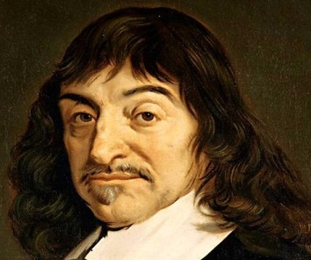
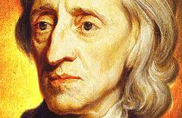
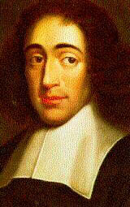
Scientific Revolution → Enlightenment: philosophical conceptualization of ‘human nature’ in rational and naturalist/empirical terms
Thomas Hobbes
(1588-1679)
René Descartes
(1596-1650)
John Locke
(1632-1704)
Baruch Spinoza
(1632-1677)

Slide 24
Rational and naturalist thinking → modern view of ‘human nature’
Traditional view of man rooted in religious dogma’s, metaphysical principles, teleological explanations and inherited customs and habits.
Explanations of man in relation to:
the concrete experience of the thinking self: rational introspection by Descartes;
man’s position in the natural and sociocultural world: empirical approach of Hobbes and Locke.
Underpinned by the idea of Natural Law: organization of human world (legal systems and social and political arrangements) should not be grounded in metaphysical and religious beliefs, but on rational/empirical knowledge of the ‘nature’ of things, including what was assumed to be the essence of human nature. → Human nature conditioned by inherent patterns and regularities and therefore explainable in rational and empirical way.

Slide 25
Concept of soul as purposeful, multidimensional spiritual and life force → secular and dual notion of mind and body
Physical: functioning of living body compared to down-to-earth mechanical operation of machines → Undermining Aristotelean explanation of organic life in terms of organic part of the soul (‘life spirits’) → Soul not relevant any more for explaining material life.
Mental: development of a secular philosophy of ‘mind’ apart from theology: mental activities such as thinking, remembering, perceiving, feeling and imagining considered in terms of faculties of the mind apart from supernatural and immortal part of the soul.

Slide 26
Soul → Mind
Large part of what was formerly understood in terms of the spiritual soul was now increasingly explained in terms of faculties of the mind.
What was left of supernatural soul became exclusive domain of theology, while philosophers reflected about a purely secular mind.
And later: scientists could investigate that mind in purely psychological or materialist terms (today’s neurophysiology and neuroscience: brain as organ of the mind).

Slide 27
New view of man: Thomas Hobbes
Radical materialist (utilitarian) view:
Man fundamentally driven and motivated by natural physical drives (‘endeavors’) which incite feelings of pleasure (‘appetites’) and pain (‘aversions’).
On the basis of the pursuit of pleasures and the avoidance of pain, every man has a natural right to preserve himself. → A first step towards the secularization and naturalization of the moral categories of good and evil, linking them to concrete physical sensations instead of a divine, supernatural purpose.
(Paving the way for scientific investigation of the mind in purely psychological or physiological/neurological terms → brain as organ of mind.)

Slide 28
New view of man: René Descartes and John Locke
Hobbes’ bold suggestion that human mind was ultimately determined by physical needs was still exceptional. Until into the 18th century tone set by Descartes and Locke.
Shared idea of a secular, autonomous, thinking self (rather than physical drives) as essence of being human.
Different views on relation between mind and body and different epistemologies: rationalism (inner-directed self-sufficiency) versus empiricism (sensual experience of the outside world).

Slide 29
Descartes: deductive rationalism
Ambition: providing new, purely rational foundation for certain knowledge in line with new mechanical worldview of Scientific Revolution.
Rigorous rejecting of received wisdom, authority of Ancient philosophy and Christian revelation, and distrust of sensual perception.
Starting with fundamental doubt and skepticism about everything including sensory information → Building new, certain knowledge on the basis of systematic reflection on one’s own thoughts: objective knowledge grounded in immediate experience of one’s own mental states → First certainty: Cogito ergo sum:
‘I think, therefore I am’.

Slide 30
Descartes: Discours de la Méthode (1637)
Descartes finding certainty in inner individual self, in operation of his own rational mind → Building certain knowledge through radical doubt and inner reflection on personal thoughts and workings of rational mind.
New rationalist method: deductive, analytical reasoning on the basis of rigorous classification and mathematical logic.
New view of man: inner-directed thinking self as essence of man ←→ material and sensual body.

Slide 31
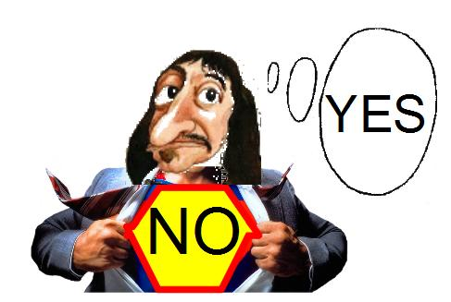
Descartes: mind-body dichotomy
Man separate from and superior to rest of nature because of rational and linguistic faculties. → Mind (res cogitans: immaterial substance) and matter (res extensa) are fundamentally different:
Matter in space and time, extended, divisible, measurable and quantifiable, and can be analyzed in mechanical terms.
Mind without extension and location, and indivisible; cannot be analyzed and quantified in natural-scientific way. → Rational faculty of the mind which can explain external reality in materialist and mechanical terms, can in itself not be explained in those terms.
The Aristotelian and Christian view of soul as combination of organic life force and spiritual, supernatural part of man.

Slide 32
Consequences of Cartesian thinking
Religious belief ←→ rational philosophy
Descartes: God as first mover having created man with rational mind and external world as regular mechanistic system → Undermining the relevance of religion for philosophical explanations of the world and man’s position in it.
Mind ←→ body
New issue: how are the immaterial mind and material body related? Descartes’ answer (interaction in pineal gland) not very convincing → mind-body problem in philosophy.

Slide 33
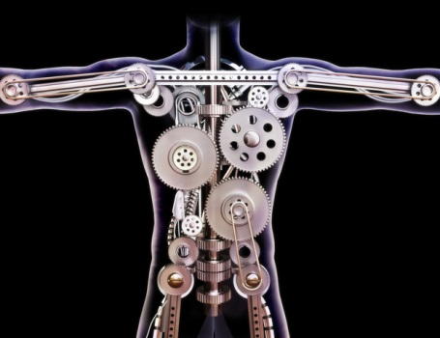
Descartes’ radicalism: materialist explanation of man’s physical and psychosomatic functions
Only pure, self-conscious reason and free will excluded from mechanistic-materialist explanations.
‘Organic soul’ and part of the ‘spiritual soul’ fully drawn into the material and mechanical body: physical and psychosomatic functions (perception, imagination, dreaming, passions, reflexes, automatic and routine activities) not explained in terms of teleological life-forces but in materialist-mechanist way.

Slide 34
Epistemological transformation Great Chain of Being → subject←→object
Platonic-Aristotelian and Christian epistemology:
Thinking and understanding = becoming aware of given meaningful order of external world.
Assumption of continuity/overlap between purposeful arrangement of world and organization of human intellectual soul.
Gaining knowledge of the world = getting access/opening ourselves to/becoming conscious of given order of things existing outside and inside us → No clear-cut distinction between subject and object, between human thought and object of thought → part of the same constellation: purposeful ‘Great Chain of Being’ full of parallels and analogies.
Cartesian epistemology:
Subject (inner self/rational mind) ←→ object (external world).
Ordered rationality is not a given ontological property of the external world (mechanical, but without purpose), but cognitive method or procedure of the human mind.

Slide 35
Empiricism: Hobbes, Locke (Essay Concerning Human Understanding, 1689/1690)
Human beings are born with mind equipped with rational capacities to process sensual experiences, but contents, ‘ideas’ (building-blocks of the mind) and ‘associations’ between different ideas, can only result from input of outside (material) world.
Next to reason, physical senses (seeing, hearing, feeling, smelling, and tasting) crucial means for acquiring knowledge; without sensual experience of outside world, empty and helpless mind. (Mind of every new-born child is blank sheet of paper and this tabula rasa is filled through sensual experience and learning.)
What is in the mind is related to and depends on the body: man as sensuous being + human ethics grounded in experiences of pleasure and pain (cf. Hobbes) rather than divine or metaphysical imperatives.
Descartes’ rationalism (self-sufficient inner reflection ←→ external material world) and strict separation of body and mind.

Slide 36
Hobbes & Locke: ‘possessive individualism’
Hobbes’ radical materialist, utilitarian (and pessimistic) view of man:
By nature human beings are egoistic, unruly and self-interested creatures and determined by bodily needs: man fundamentally driven and motivated by natural physical drives (‘endeavors’) which incite feelings of pleasure (‘appetites’) and pain (‘aversions’).
On the basis of the pursuit of pleasures and the avoidance of pain, every man striving for preservation of most basic and precious possession: body and life.
Crucial step towards secularization and naturalization of moral categories: good and evil linked to concrete physical sensations instead of divine, supernatural purpose.
Idea that human beings have an inalienable natural right to protect themselves against pain and premature death based on assumption that individuals are owners of their body (and mind) → possessive individualism: starting-point of liberal focus on individual self-interest and self-determination, crucial for modern political thinking (liberalism, civil rights and democracy) and capitalist economy (entrepreneurship).

Slide 37
Locke’s elaboration of possessive individualism
Not only possession of one’s body, but also of cultivated soil and goods is such a right, because what the body develops and produces by means of labor is the rightful property of the person who owns that body (→ Capitalism: link between production and ownership).
Likewise, individual is rightful owner of other products of their body as well as their mind: thoughts, opinions, memories, feelings, acts, experiences, desires, talents and capacities.
As sole owner and manager of all personal qualities, the self-interested individual has a natural right to self-determination: one should be free to decide for oneself what one does with one’s possessions as long as others are not harmed and hampered to exercise same freedom (→liberal political doctrines).
Definition of individual in terms of self-reflection, self-reliance and accountability.

Slide 38
Locke: inner mental life as the essence of personal identity
On the basis of argument about possessive individualism, articulation of secularized notion of modern individual (already defined by Descartes in terms of rational self-reflection) as autonomous and self-responsible person.
Possession and management of mental powers and qualities, in particular memory, guarantees continuity of personal consciousness enabling individuals to experience themselves as same being in different places, social settings and times, to have a personal identity apart from one’s social position and moral destiny of one’s soul.
Such identity, essential for recognizing all one’s thoughts and actions over time as one’s own, and for reflecting and judging on them, enables individuals to take personal responsibility and to be accountable for them and also: to be a subject as well as an object of self-knowledge.
→ together with empiricist epistemology, this philosophical presupposition underpinned the possibility of the human sciences.

Slide 39
Political background: ‘Natural Law’ and liberal thinking
Natural Law: a legal and political discourse centering on the idea that legal systems and political arrangements should not be based on metaphysical principles and religious belief, but on knowledge of the ‘nature’ of things, including what was assumed to be the essence of human nature. (Central idea in the Enlightenment)
John Locke and 18th-century enlightened thinkers defining man in terms of rationality and free will as well as of inherent rights: individuals who are fully capable of using their rational mind and free will can be self-responsible and therefore deserve certain inalienable rights → Their self-preservation, self-determination and self-development should be respected, precisely because man’s desire for them are supposedly given in a basic and universal human nature.

Slide 40
Social-economic background
Modern self in philosophy reflecting social realities: rise of individual as practical and self-responsible agent who is able to act upon both nature and society to achieve self-chosen ends in the context of the erosion of traditional collective and hierarchical social structures as a consequence of:
development of commerce and capitalist market;
growing geographic and social mobility;
emergence of a bourgeois/middle class;
increasing role of the modern centralized state undermining traditional hierarchies and standardizing and equalizing social relations.

Slide 41
Individualism in modern society
Personhood, human beings are not just representatives of collective social entities to which they belong.
Behind their public self (social role-playing and keeping up appearances), there is a deeper ‘authentic’, ‘true’, ‘real’ self.
Such sense of subjectivity and privacy reflected in autobiographical writings (diaries, letters, and personal (self)portraits) from the 16th and 17th century on → origin of psychological discourse as way to talk about personal feelings and individual character.

Slide 42
Body-mind dualism→ holistic/psychosomatic view of man (assignment 1)
Descartes:
mind is immaterial/metaphysical phenomenon outside/above the rest of nature
the body is like a machine that can be explained in mechanical terms
‘Holistic’/’psychosomatic’ perspective on man in empiricist/sensualist philosophy and medical-physiological research:
Close connection between the body as a sensitive organism and the ‘moral’ part of man (thinking, feeling and social behavior).
Mind naturalized: increasingly associated with the working of the body, more and more drawn into the body and ‘de-centralized’ (Moravia) → man as a psychosomatic, sensuous being (focus on the senses and nervous system as the link between body and mental processes).
Vitalist explanations of life in medicine and biology → assignment 2.

Slide 43
‘Anthropology’ as a new field of knowledge
The comprehensive study by physicians, physiologists, educators and philosophers of man’s physical as well as ‘moral’ (mental, behavioral, sociocultural) nature, of how man was determined by inborn traits and the environment.
Anthropology → in the course of the 19th century differentiation in disciplines: biology, experimental physiology, natural scientific medicine, psychology, psychiatry, neurology, criminology, ethnology/cultural anthropology and sociology.

Slide 44
Physical anthropology Craniometry

Slide 45
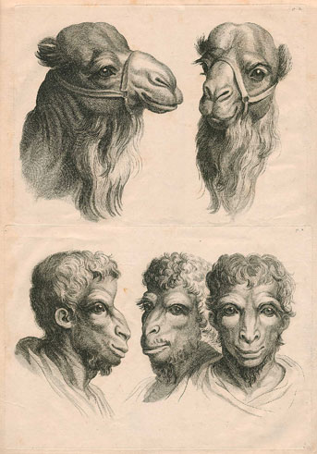
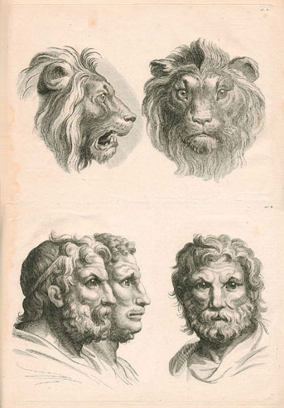
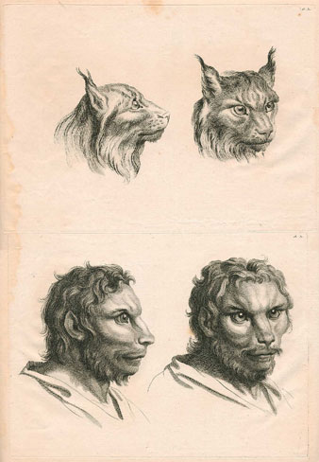
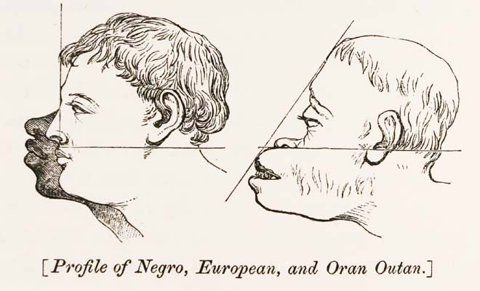
Physiognomy

Slide 46
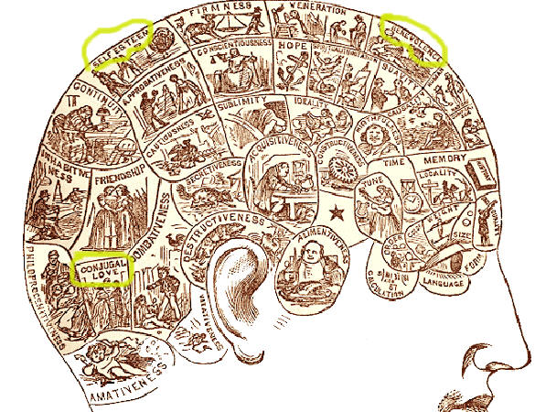
Phrenology

Slide 47
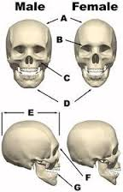
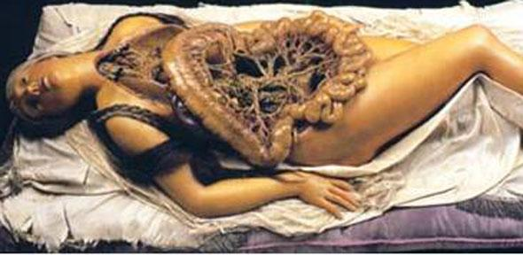
The gendered body

Slide 48
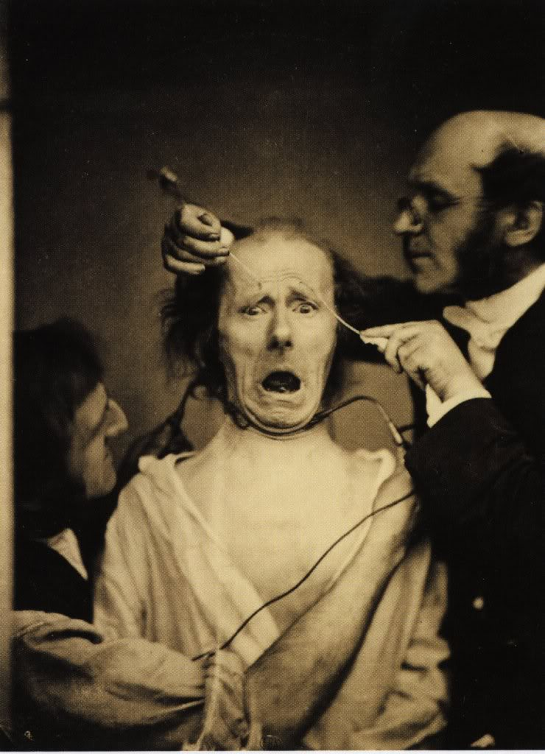
Madness, wildness, ‘our inner Africa’ →psychiatry

Slide 49
The human sciences in Germany: self-development and ‘Bildung’
Bourgeois identity: the importance of self-reflection and rational conduct for a self-controlled life.
‘Anthropology’ as a practical guide for life in civil society (Immanuel Kant) → personal autonomy and intellectual and cultural shaping of the self (Wilhelm von Humbold: Bildung).
Popularization of anthropological knowledge:
‘Psychological’ discourse in popular-scientific publications.
Investigating individual character → interest in physiognomy (Lavater) and frenology (Gall & Spurzheim).
Growing popularity of autobiographies and novels describing the inner life of characters → (Romantic) values of personal sincerity and authenticity.

Slide 50
The human sciences in France: The Revolution and the ‘Ideologues’
‘Ideological’ project during French Revolution and Napoleontic era: establishing comprehensive empirical science of man based on sensualist philosophy and broad medical knowledge → Basic assumption: Health and good life depend on interaction between constitution, habits and living-conditions.
Applying scientific knowledge about man → Improving personal and social life through rational education and social hygiene; a rational organisation of society (reform proposals in the field of education, medicine, justice, poor relief, and the care of the insane and social hygiene); establishing models for sensible (democratic) citizenship.
Sociopolitical background: the turmoil of the French Revolution and the Napoleonic era → Worries about social disintegration → Broadly-felt need for a new view of man that was geared to ground-breaking sociopolitical change and could include differences between individuals and groups, while simultaneously establish an objective and neutral standard for modern individual and social life → Balancing the instability of and discord in politics and democracy by firm and unbiased scientific expertise.

Slide 51
The human sciences in Britain: The Industrial Revolution
Social-economic modernisation: the need for social reform geared to a rational and efficient organisation of industrial society → emphasis on productivity and utility.
Jeremy Bentham and ‘Philosophical Radicals’ (James/John Stuart Mill, Ricardo, Chadwick): reform of society on the basis of scientific knowledge about man and society, and inspired by an empiricist-sensualist view of man → Strong belief in the malleability of man: man should be shaped and improved on the basis of education, legislation, the organisation of the environment, social-scientific knowledge (statistical registration: making society transparant) and systematic surveillance (Bentham’s panopticon).
Scientific knowledge about man as a secular and practical guideline for ethics and social policy → Utilitarianism.

Slide 52
Bentham: Utilitarianism
The principal human drive is hedonistic and egoistic: the avoidance of pain and discomfort and the striving after pleasure and happiness.
The need to bend the basically hedonistic and egoistic nature of man into a beneficent, social and moral direction by establishing not individual but collective happiness as a moral standard → the principle of ‘the greatest happiness of the greatest number’ as the measure of right and wrong → the moral quality of an human act depends on the amount of happiness which it adds to the total amount of happiness → individual self-interest and the common good harmonized; the promotion of the public interest would eventually benefit all individuals.
Realizing the greatest happiness of the greatest number on the basis of Bentham’s ‘hedonistic calculus’ → efficient utility, a rational measure for right and wrong, as the dominant moral principle in social engineering and planning.
Reform-proposals in the field of law, health and disease, social policy, poverty relief, education and the fight against crime → Social technologies in order to make society transparent and surveyable:
Statistical registration of the population and the economy;
The Panopticon.

Slide 53
Bentham’s panopticon
Architectural model for prisons, poor houses, work houses, factories, mental asylums, hospitals, schools and the army.
Historical background: increasing institutional segregation of groups considered as a nuisance in modern industrial and urban society because they did not meet the requirements of productivity, rationality and efficiency.
New institutions: poor- and workhouses for the poor, the unemployed and tramps; prisons and reformatories for criminals and vagabonds; asylums for the insane and the handicapped; and hospitals for the ill.
Objective: re-socialization and bringing back problem groups to reasonableness and productivity through a strictly regulated institutional environment and a regime of systematic observation, classification, experimentation, inspection and surveillance for different purposes → confining suspects, punishing/correcting criminals, guarding/treating the insane, reforming the vicious, employing the idle, treating the sick, preventing the spread of epidemic diseases, educating children, instructing/disciplining laborers and soldiers.
→ Ultimate goal: Internalization of the surveying gaze → self-regulation.

