Slide 1
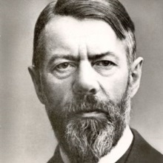
Max Weber Modernity as rationalisation
Harry Oosterhuis

Slide 2
Significance of Weber
One of the most influential sociological thinkers on modernisation → interpretation in terms of rationalisation and the associated reflection on the bright and the dark side of modernity still relevant.
Next to Emile Durkheim, the most prominent founder of the discipline of sociology, not only because of his empirical research and his theoretical notions, but also because of his view of the nature of sociology as a science. → Sociology belongs to the humanities or the cultural sciences.
Weber's sociology is interdisciplinary and rooted in historical thinking → is work has been held in high esteem by modern sociologists as well as historians.

Slide 3
Outline
Weber’s personal background
Tension between science and politics
Social-historical context of Weber’s work
Nature of social and cultural sciences
Modernisation as rationalisation and disenchantment → paradoxical outcomes

Slide 4
Personal background
Born in 1864 in a bourgeois-patrician family
Father: a prominent lawyer and politician in Berlin → young Max in contact with leading politicians and scholars.
Mother: rich protestant family of capitalist entrepreneurs from the Rhineland; protestant and engaged in philanthropy and social work.
Social background:
Bildungsbürgertum → the German upper middle class distinguishing itself by education and an interest in culture and the arts.
Wirtschaftsbürgertum → capitalist bourgeoisie: no-nonsense values of enterprise, practicality, discipline and hard work.

Slide 5
Broad intellectual and disciplinary background
Studies: economy, law, history, philosophy
More than 200 publications → interdisciplinary sociological studies:
social-economic history,
history of law,
sociology of religion,
relations between economy - law, religion, and politics
Political essays

Slide 6
Weber ←→ Marx: same wide-ranging ambition but different approaches
Weber and Marx: interrelating various domains of social life (economy, social relations, politics, culture, ethics), but different ways of explaining.
Marx’s historical materialism: economy and technology (substructure) comes first and determines ethical, intellectual, social and political life (superstructure).
Weber’s criticism of Marx: one-sided reductionism → relations between different fields (e.g. economy/politics or religion) and between ideas and material factors, are complex and mutually influence each other → In explaining sociocultural phenomenon, material factors should not be prioritized over ideas, religion or political power, or the other way around.
The Protestant Ethic and the Spirit of Capitalism (1904/05): rise of capitalism not explained only on the basis of developments in technology and changing means of production. Capitalism also advanced by certain way of thinking, believing and behaving, which originated in branch of Protestantism, Calvinism → Capitalism partly a product of religion ←→ Marx: capitalism product of material (technological and economic) causes and Protestantism as the justifying ideology of material realities of capitalism.

Slide 7
Weber’s existential crisis
Troubled man + chronic psychosomatic ailments (‘neurasthenia’?) → 1898-1902: mental crisis: depression, unable to work.
Background: contradictions and tensions in his personality and doubts about the true purpose of his life: Passion for politics ←→ passion for scientific knowledge.
Strong political and social convictions, concerned about the development of modern society and about the fate of the German state and nation → politics implied ideological commitment as well as action and power-play.
Sociological analysis requires a distanced, more objective approach.
Health problems → abandoning (stressful) political career and opting for scholarship, although regular writings about politics and delivered political speeches. (Involved in politics after First World War and possibly political role in Weimar Republic, had he not died in 1920 at 56.)

Slide 8
Weber’s anti-utopian realism: power as the driving force in human life and politics
Human beings are inevitably committed to variety of interests, ideals, values and purposes (‘eternally warring gods and demons’) → Life and politics involves ongoing conflict and struggle (parallel with Nietzsche).
No objective, rational way to decide which interest, ideal, value or purpose is intrinsically true or good → which of these will dominate depends on the exercise of power and coercion: predominance of some wills, choices and values over others is inevitable and essential in politics.
Politics/democracy may be driven by ideals and ideologies, but in order to realize them power-play is indispensable.
The realization of a perfect/harmonious society through politics/democracy (Rousseau, Hegel, Marx) is a chimera.

Slide 9
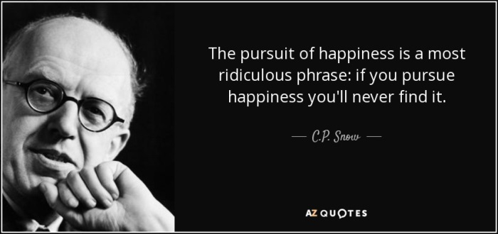
Disenchanted outlook on life
“Not summer’s bloom lies ahead of us, but rather a polar night of icy darkness and hardness.” (Max Weber)
“Sometimes we escape from solitariness through love or affection or perhaps creative moments, but those triumphs of life are pools of light we make for ourselves while the edge of the road is black: each of us dies alone.” (C.P. Snow)

Slide 10
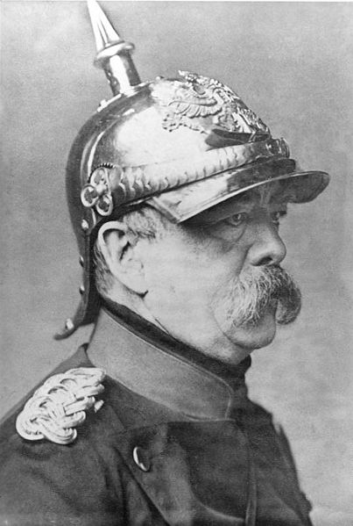
Weber’s passion for politics: problems of new Germany
1871: unification of Germany (Bismarck) through warfare → rapid social-economic modernisation and German Empire growing into one of the most powerful countries in Europe.
Weber as a nationalist: proud of his Fatherland
and German culture.
However, at the same time critical awareness of:
Tensions/imbalances in German Empire:
- Socio-economic modernisation ←→ authoritarian rule and militarism
- East (Prussia): agrarian ←→ West/South: urbanised, industrialised
- aristocracy ←→ bourgeoisie ←→ labour class
failure to establish liberal democracy (←→ Western Europe)

Slide 11
Problems of modern Germany
Unbalanced political structures: leadership of Prussia with land-owning and militarist aristocracy elite ←→ economic centre shifting to bourgeois capitalists in industrialized, urbanised and more liberal West.
Lack of strong democratic forces because of political shortcomings of the bourgeoisie:
In order to adjust political relations to changing social-economic conditions, the aristocracy’s leading role would have to be taken over by the bourgeoisie. → However, no successful liberal-bourgeois take-over → middle class unfolding its economic and cultural ambitions, but lacking ability and willingness to take political responsibility and challenge aristocratic dominance and powerful state bureaucracy.
Complications of the ‘social issue’: rise of the industrial labour class and its antagonism vis-à-vis the aristocracy as well as the bourgeoisie → Bourgeois fear of a socialist revolution → acceptance of aristocratic domination and thus hampering democracy.
Weber: how to get out of this stalemate and integrate working class in the nation in a peaceful way → Inevitability of democratisation in order to prevent a socialist revolution → German state had to embrace socialist objectives (e.g. social legislation) instead of socialism taking over the state (←→ Marx).

Slide 12
Weber’s political orientation: nationalism, liberalism, social-democracy
Requirements for democracy according to Weber:
Parliament on the basis of universal suffrage and free competition of ideals and values.
No direct but representative democracy: government by a meritocratic elite of professional politicians on the basis of a popular mandate and charismatic leadership.
Well-organized bureaucracy in order to guarantee legal procedures, equal treatment and efficient implementation of (social) policies.

Slide 13
Sociology/cultural science in Weber’s view
Central characteristic of culture and social life: people give continuously meaning to their own and other people's behaviour → Object of sociology and cultural sciences is human behaviour that is related to the behaviour of other people and that implies meaning, intention, judgement/evaluation and purpose → social behaviour oriented towards shared (social, cultural, ethical, religious and political) values.

Slide 14
Social and cultural values: answers to fundamental questions about human existence
How do we give meaning to life and what is the good life? → Religious and ethical values.
What is right and what is wrong? → Religious, ethical and legal values.
How do we associate with others? → Social values.
How do we organise society? → Political and ideological values.
How do we guarantee the security and interests of our society or state? → Political and military values.
How do we provide for our material needs (food, shelter and goods)? → Economic and technological values.
How do we explain and control the natural world? → Scientific and technological values.
How do we handle our emotional and physical needs? →Sexual and family values.
How do we fulfil our aesthetic needs? → Artistic values.

Slide 15
Value-relativism
In the social and cultural world there are no fixed and universally given and shared meanings and priorities (there is no final truth in values):
Specific contents of values are diverse and open-ended → variations between different cultures and historical periods.
Variation and change in the hierarchy of values, the way people or cultures prioritize certain ones over others.
Cultural and social sciences study the wide variety of interpretations of reality by which people confer meaning on their (co-)existence without being able to determine an objective, ultimate truth about the specific contents and priority of such interpretations and meanings.
In modern society priority of economic and technological as well as individualistic values ←→ in the past and in other cultures other values prevail: tradition, religion, honour and respect, collectivism, social cohesion and bonds of loyalty and duty.

Slide 16
Values → Weber’s strict separation of science and politics
Politics:
Essentially about choosing between different values, being committed to certain ideals, and struggling over de priority of particular values and ideals.
Continuing discussion and power-struggle about the question how the world should be and the attempt to change the world according to certain ideals.
Science:
Should be value-free in the sense that study and analysis should be strictly separated from subjective appreciation, from ideals and strivings, from politics.
Understanding and explaining how the world is, not about how we would like it to be.
Kant's essential distinction between sein and sollen, between scientific knowledge about what is, the part of reality that is determined by natural laws, and on the other hand ethics, which is about what ought to be: dimension of moral responsibility presupposing freedom and imperative to choose.

Slide 17
Relation between sociology/cultural sciences and values/value-judgements
Social and cultural sciences have social, cultural, ethical and political values as their object of study: society and culture are organised on the basis of values and people live according to such values.
Values can inspire the scholar to choose for a certain research-subject: studying social and cultural reality, the scholar's mind is not a blank sheet → social and cultural scholars will always be part of a certain society and culture in a particular time period → involvement guiding the choice for and relevance of subject of study → Social and cultural sciences are value-oriented: values are not only object of study, but they may also direct the scholar's choice for certain subjects (Weber's own work certainly value-oriented: he selected his research topics on the basis of the social and political issues of his time).
Just like natural science, sociology and the cultural sciences should be free of value-judgements → not mixing up what is and what ought to be.

Slide 18
Social and cultural scholarship: inspired by values and studying values, but without evaluating these values
Scholars studying the values to which other people (in present or past, in same or in other cultures) are oriented and attached, should not judge on them, not prefer or disqualify such values
→ there is no objective scientific foundation for such a judgement.
Weber’s study about the relation between Calvinism and capitalism, linking religious and economic values: no answer to the question whether Calvinism and capitalism are good or bad, whether they should be promoted or suppressed. Weber: such a question does not belong to the domain of social science, but to that of politics or ethics.

Slide 19
Cultural and social science: no answer to questions about the good life or the best society
Social and cultural science cannot determine which values are 'true' or false and superior or inferior, for which values people should choose → it cannot not provide guidelines for what people should do or believe in, which values they should life by.
It can only explain human behaviour by clarifying how it is oriented to certain values, how, in a particular cultural and historical setting, certain values are interconnected and how they (may) have certain consequences.
Rejection of value-judgement by scholars → blurring of the boundary between science and politics and undermining objectivity of science. (Qualifying superiority or inferiority of certain values? → Do so as citizen or as politician, but not as scientist or teacher.)

Slide 20
Weber’s struggle with values and value-judgements
Did Weber himself in his own life always lived up to these principles? It was difficult for him not to judge on social, political and cultural values. → → torn between the world of science and that of politics, which he believed should be kept apart.
In personal life tormented by tension between the values to which one can commit oneself in modern society in order to give meaning to life: oriented to public, economic or professional ambitions requiring order, regularity, self-discipline, practicality and hard work ←→ priority of the personal: emotional dimension of spiritual values, religious belief, love and eroticism, aestheticism and art.
Tension between diversity of values characteristic of modern condition: individual struggle with such choices → Weber’s very personal motivation for his scholarly work: 'I want to discover how much I can personally endure.' → some findings of his studies about modernisation gave cause to a rather gloomy outlook on life.

Slide 21
Methodological orientation of sociology towards the humanities
Collective orientation towards cultural values as the essence of social life → sociology’s methods similar to those of the humanities (history, cultural philosophy, art and literary studies).
In line with the argument of some German philosophers (Dilthey, Rickert and Windelband) that the humanities or cultural studies are fundamentally different from the natural sciences and do not meet positivist standards.

Slide 22
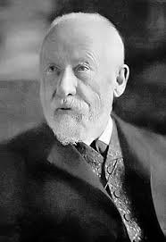
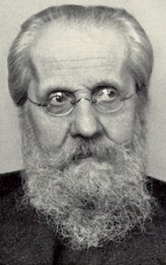
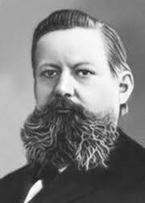
Natural sciences ←→ Cultural studies Wilhelm Dilthey, Heinrich Rickert, Wilhelm Windelband:
objective material external world ←→ subjective spiritual inner world
mechanistic operation ←→ contents of values
causal laws ←→ meaningful relations
determinism/predictability ←→ historical approach
abstraction ←→ focusing on the unique
generalisation ←→ specification
quantification ←→ description
experimentation ←→ introspection
analysis ←→ understanding
erklären ←→ verstehen (hermeneutics)

Slide 23
Weber: sociologists should combine understanding and explaining
Understanding → Since cultural and social reality is the product of the meanings and values which people attach to their behaviour, the sociologist can gain knowledge about people as social beings only through interpretation from the inside, with the help of intuition, empathy, identification, and imagination on the basis of their own experience of life. → Hermeneutic method: reconstructing the motives, the intentions and other subjective experiences of social actors and thus understanding how these were related to more generally shared social and cultural values.
Explaining → Tracing general patterns and regularities in social and cultural values in order to explain how they are related to each other. Individual meanings and behaviours are not just arbitrary and individually unique. Social actors orient their behaviour towards values within social and cultural settings, in which individuals share basic values and meanings. These shared values and meanings have crystallised in relatively durable and stable social systems, in cultural codes, expectations, arrangements and institutions, which then determine further social interactions. → Generalisation and explanation are possible because social life is based on the regularity and overall predictability of human behaviour within a certain social and cultural context.

Slide 24
Comparison and ideal-types
The sociologist's task: discovering regularities and general patterns in great variety of ways human behaviours are oriented towards cultural and social values.
Applying the comparative method: comparing human behaviour and institutions in different cultures and in different historical periods → establishing similarities and differences.
Devising specific concepts, the so-called ideal-types → analytical models that generalise, accentuate and simplify the messy empirical realities and their endless variety: basic sociological conceptual tools which enable an orderly perspective on the social and cultural world.
Weber has designed several ideal-types and some of them are well-known.
E.g. charismatic leadership: part of Weber's typology of political authority and power, and their legitimation. Next to charismatic authority: traditional and legal-rational authority.

Slide 25
IDEAL-TYPES OF SOCIAL ACTION How behavior is oriented towards dominant social/cultural value-patterns
Traditional action
Irrational
Affective/emotional action
Goal-oriented action
Rational
Value-oriented action

Slide 26
Traditional and affective action implying irrationality
Traditional action: rooted in custom, established conventions and unquestioned authority → what always has been done in the past is intrinsically valid and good, and should be respected and maintained, because it is sanctioned by a given divine or supernatural order and religious belief-system.
Affective or emotional action: individually conditioned by unreflective and more or less uncontrolled impulses, spontaneous responses, emotions, intuitions, feelings and drives.

Slide 27
Goal-oriented and value-oriented action implying rational reflection
Goal-oriented rational action: deliberate action in which goals and means, costs and benefits, and any effects and side-effects are all carefully considered and balanced → the instrumental adoption of the course of action that is functionally the most efficient to realise a set goal and which enhances success and minimizes cost or harm.
Value-oriented rational action: realisation of a fixed belief, ideal or conviction prioritized, and rational means to realise them subordinated, without considering possible costs, effects or side-effects → → The end justifies the means.

Slide 28
Goal-oriented and value-oriented rational action:
Both typically modern forms of behaviour, but contrasting moral attitudes:
Goal-oriented rational action: goal not made absolute, but means and ends balanced and adapted to each other.
→ Practicality, pragmatism, flexibility and compromise and related to ethics of responsibility (Verantwortungsethik).
Value-oriented rational action: value (conviction/ideology) to be realised made absolute, whatever costs and consequences; no compromise and flexibility, but rigidity and fanaticism.
→ The end justifies the means: ethics of conviction (Gesinnungsethik).

Slide 29
Modernisation as rationalisation:
Historical process: traditional as well as affective action more and more replaced by rational action.
Increasing internalisation and institutionalisation of rational action: rationality not only determines social behaviour, but also social organisation, institutional procedures, technologies, attitudes: all our ways of thinking, knowing and doing → spreading in many social spheres: economy, politics, law, administration, science, technology, ethics and even in the arts and religion.
Scale, extension and intensity of rationalisation distinguishes the Western world from the rest and explains its success: this mode of action has spread from the West all over de world.

Slide 30
Traditional and affective-emotional behaviour reduced
Traditional and affective behaviour not completely disappeared and may still be considered valuable, but significance for public social life reduced. In the public sphere irrational behaviour generally considered as dysfunctional:
→ Self-evident respect for the past and custom as guideline for behaviour has dwindled and is mainly only relevant in ritual and folklore.
→ Affective-emotional behaviour has been pushed back to private sphere.

Slide 31
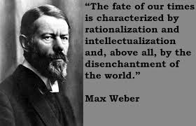
Instrumental (not substantial) rationality: about the means (how), not the contents of goals or values pursued (why).
Choosing rational means not based on some sort of truth or inherent goodness, but on their functional effectiveness or usefulness: they work well.
Rationality: the reflective selection of the best available means to realize goals → not substantial but formal and instrumental: methods and procedures that can be applied in a general and universal way in many different situations and contexts.
rules/techniques of efficiency, effectiveness, functionalism, practicality
calculability, controllability
coherence, consistency, predictability
system, orderliness, regularity
standardisation
methodical way of working, planning

Slide 32
Rationality: about the ‘how’, not about the ‘why’, for what purpose.
Rationality does not refer to the contents of goals or values to be realised; these can be completely irrational.
Rationality applies to the criterion of effectiveness, choice between means which will produce the best or optimal results with regard to objective or value that is to be realized.
It does not offer an objective standard with regard to the best choice between various goals, value systems or ideals. That choice will always be an irrational, a political or ethical one.
The ‘eternal struggle between values’ cannot be resolved by (instrumental) rationality.

Slide 33
Example of goal-oriented action: industrial capitalism
Rational technical and economic methods of industrial-capitalist system → rising living standards and world of plenty.
Does not imply that capitalist value-system in itself (focusing on investing, making profits, and continuously producing and consuming more goods and throwing them away if they are not fashionable any more) is rational → Harmful side-effects: increasing social-economic inequalities; one-sided attachment to materialistic values; undermining of social values like social justice, solidarity, and sustainability; environmental pollution, depletion of natural resources and climate change.
Have the pragmatic goals of industrial capitalism (improving material conditions of life) changed into the value-absolutism of limitless economic growth and profit-making without meaningful intrinsic purpose?

Slide 34
Example of value-oriented rational action: the Holocaust
Irrational, absolute objective of National Socialists, the extermination of all Jews in Europe on the basis of the value that Jews are harmful and undermining the ‘Aryan race’.
But that does not alter the fact that the means used to realise this aim (bureaucracy, logistics of the operation, transport systems, orderly organisation of concentration camps and massive, industrial way of killing) were rational.

Slide 35
Other examples of value-oriented rational action: 9/11 and IS
Irrational goal of the terrorist 9/11 attack on the Twin Towers in New York (2001) - spreading death and destruction on the basis of religious conviction or revenge.
But the means used - accurate calculation and planning, operation of modern technology, and skill to navigate an aircraft - were rational. Successful terrorism, not only because of strong religious motivation in itself, but because of skills to use rational methods.
See also terror by Islamic State, employing modern technology, rational administration, internet and effective propaganda-strategies in order to realize religious values that are far from rational.

Slide 36
Rationalisation as a process typical of the Western world
In the last four centuries in particular goal-oriented rational means and procedures have become dominant in many social fields and institutions.
Strength of instrumental rationality: formal procedures and practical methods which can be detached from specific social and cultural settings and universally applied in many contexts → increasing efficiency and effectiveness, progress in many fields.

Slide 37
Science and technology
Since the Scientific Revolution, systematic knowledge striving for predictability and the dominion and manipulation of nature by means of mathematics, mechanistic thinking, and experimentation.
(Science as the activity/domain in which rationality is not only instrumental, but also substantial in the sense that the values of science refer to rationality in itself.)

Slide 38
Capitalism and industrial production
Rationalisation of production and distribution of goods, realized by carefully balancing of ends (regular profits) and means (investment), planning, calculating costs and benefits, functional efficiency, the (Protestant) work ethic (work as an end in itself), utilitarian thinking, rational bookkeeping, formal accounting procedures, standardised contracts, and a separation of objectified business interests and subjective private life.
And related to capitalism → Industrial production on the basis of extensive division of labour, mechanisation, systematisation and standardisation of work-processes in large-scale and carefully organized factories.

Slide 39
European law system
Legal codes based on Roman law and later on Napoleon's Code Pénal en Code Civil →logical, consistent, calculable and predictable systems of rules and procedures, in which particular rules are deduced from more general rules, in which punishment is proportional to the seriousness of crime and the degree of guilt, in which disputes can be solved by a careful balancing of interests, and which guarantees transparency and predictability.

Slide 40
Modern state and bureaucracy
Modern state, which came into being on the basis of monopolisation of violence, introduction of uniform and rational systems of law and taxation, of bureaucratic administration, co-ordination and planning, and rationally organised armies. Centralised bureaucratic state the rational institution par excellence, which, through its policies of social planning, advanced rationalisation in the rest of society.
Bureaucracy: objective and standardised treatment of individual persons and cases in order to organise and administer institutions in a systematic, transparent and predictable way and to exclude uncertainty, arbitrariness, favouritism and unequal treatment.

Slide 41
Modern time regimes and insurance
Ubiquity of clocks, watches and pocket-calendars and how modern man uses time as an efficient means: living by fixed time schedules, separating times for work and leisure, planning and managing time in an economic way as if it is a precious good.
→ 'time is money';
→ 'don't waste time';
→ 'use your time in a useful way';
→ 'invest time in your study'.
Calculated experience of time as scarce good that has to be used optimally, far from self-evident in traditional society and still not in other cultures.
Insurance: mastering uncertainty and fate through the calculation of probability and risk, and their costs → insurance is the endeavour to calculate and control what may happen in the future.

Slide 42
Monotheistic religion
Judaism, Christianity, and Islam encouraged rationalisation → break with animism and magical thinking (belief that all of nature is inhabited and moved by erratic spirits).
In Catholicism rationalisation in monastic tradition → systematically organised practice of believing, methodologically working and living according to ascetic rules.
Protestantism, Calvinism in particular: further disenchantment by banning magical elements of Catholicism, (rituals, sacraments, belief in miracles and worship of saints) → Protestant belief that God possesses absolute sovereignty, but without direct intervention in the world like a magician. Instead: obeying God’s will by systematically following certain rules of good conduct in daily life and methodically organizing your life in line with his prescriptions.

Slide 43
Rationalisation→ Disenchantment
Disenchantment: world more and more stripped of magical meanings → undermining belief in supernatural, unpredictable and uncontrollable forces.
Weber's ambivalent assessment of rationalisation and disenchantment:
Instrumental rationality source of substantial achievements of modern Western civilisation → most effective means to realise practical goals and to realize a better life (control over nature, banning all kinds of dangers and risks, high standard of living, fair systems of justice, the functioning of large-scale democracies, of which bureaucracy is part and parcel).
Downside: rationalisation, because of practical success, creates its own dynamic and tends to become an end in itself instead of just serving as a means to substantial ends → unintended problematical side-effects.

Slide 44
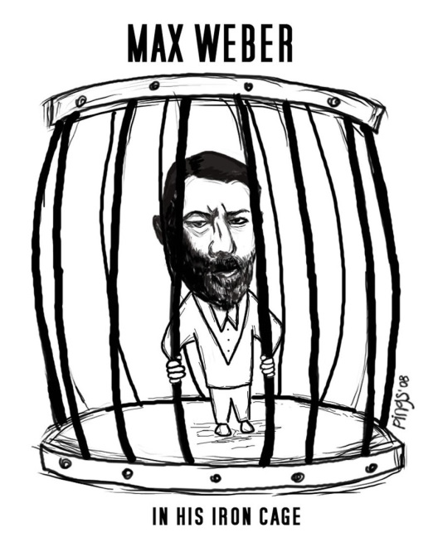
Problematic consequences of rationalisation and disenchantment
Undermining of certain value-orientations: modern life is 'soulless‘, encapsulated in the 'iron cage‘.
Loss of the certainty
about purpose and meaning
in/of human life.
Irresolvable tension of rational means versus irrational values.

Slide 45
1. Rationalisation may undermine value-orientations, which partly belong to the very nature of modernity
Instrumental rationality penetrating in more and more areas of life and social institutions → man increasingly trapped in a web of formal rules, technical expertise, expert management, administrative and bureaucratic procedures and routines entailing uniformity, conformity and standardisation of behaviour → Characterisation of modern life as 'soulless', as being caught in an 'iron cage‘, undermining the values of human freedom, individuality, initiative, responsibility, creativity, imagination, and risk-taking.
Calculated rationalized behaviour entailing depersonalisation → treating others in an objectified way, making them into means for our purposes ←→ Kantian moral imperative (that we should never treat other people just as means) and basic democratic values.

Slide 46
2. Loss of certainty about the purpose and meaning of human life
Disenchantment: continuing unmasking of certainties and given values as untenable myths and illusions → undermining fixed values as guideline and orientation in life.
Science: nature operates blindly and mechanically and religious and spiritual beliefs are not sacred truths but human projections that are historically and sociologically explainable. (See Darwin's theory of evolution, Marx’ historical materialism and Freud’s psychoanalysis).
Secularisation: Christianity as overarching meaning-system questioned (Nietzsche: ‘God is dead’ = there are no given meanings and purposes in life; we should find out on our own what makes life worth while)
Post-modernity: criticism of modern, enlightened belief in progress.
What can we believe? What is the purpose of life? → Rational or scientific answer not possible → Disillusionment and permanent doubt; individuals more and more thrown back on themselves and struggling with existential issues on their own.
Modern man facing that there are no given and definite values any more → Individual task of finding way amidst a plethora of (religious, ethical, economic, social, political, and aesthetic) value-systems, and individual responsibility for any choice made.

Slide 47
3. Irresolvable tension of rational means versus irrational values
Modern society dominated by instrumental rationality
Choice for rational means and the goals to be realised through them cannot be rationally founded: they are based on effectiveness through which irrational value-orientations, convictions and ideals (the domain of culture, ethics and politics) can be realized.
Continuous struggle between value-orientations → 'the eternal demonic war of competing gods' without any perspective of a definitive agreement that can be rationally justified. → Choice for rational means has become paramount, not because they are true or good, but because of their functional effectiveness.
→ But functional and effective for what purpose? → No rational answer possible: the values and purposes of the human world are and will remain fundamentally irrational.

Slide 48
Weber’s anti-utopian stand
History as ongoing conflict, competition and struggle for power in order to realize (irrational) values without any pre-ordained direction and destination or any promise of ultimate rational harmony.
Hegel and Marx believing that political ideals could overlap with substantial rationality on the basis of their vision of history as a logical and predetermined process, in which a rational purpose unfolded itself and would be eventually realized:
Hegel → the conflation of reason and reality in the perfectly enlightened state.
Marx → the removal of social and economic inequality and the realisation of a classless society in communism.

Slide 49
Weber’s personal struggle with disenchantment
Worrying consequences of rationalisation not mere theoretical, abstract problems. → in his own life (troubled personality and mental crisis) existential doubts and conflicts about meaning-giving values.
With all of his ambiguities of his personality and his ideas, and also with his pessimistic and tragic view of the world, Weber more realistic than many other social and political thinkers, who cherished utopian ideals about a better world.
Weber's work in our disillusioned world of today → Basic dilemma's and problems that Weber articulated, are issues which are still here with us.

Slide 50
Undermining belief in rational nature of man: parallel Weber and Freud
Freud: man is a torn being, determined by inevitable and irresolvable tensions:
in himself between opposite instinctual drives (Eros, Thanatos) and between instincts and the ‘superego’ (moral consciousness);
between himself and the demands of civilisation.
Man can never be in harmony with himself and with the world in which (s)he lives → Man caught in an unending struggle between deep-seated inclinations and need to tame them―human happiness will for ever be an illusion.
Demystification of man’s self-understanding as a rational being who is in control of the world, part of a longer trend:
→ Coperni­cus: the earth is not the centre of the universe.
→ Darwin: human beings are, just like other organisms, the outcome of blind natural forces.
→ Freud: the conscious ego is not the rational supervisor, but rather the servant of unconscious instinctual drives and desires.
→ Nietzsche and Weber: man is driven by an irrational will for power.

