Slide 1
The Modernization of Sexuality and the Emergence of Psychological Man
Harry Oosterhuis

Slide 2
Can one fall in love without knowing (having learned) what ‘falling in love’ is about and how one has to act? Love and dating based on social imitation?
Are love and sex intrinsically intertwined?
Is human sexual behavior (involving other people/partners) spontaneous and ‘natural’ (or historically, socially and culturally conditioned)?
Does ‘sexuality’ have a history? Do ‘sexual’ experiences and feelings change in time?
Man’s mental make-up basically the same always and everywhere or shaped (in different ways) in culture and history?

Slide 3
Historical patterns of making sense of ‘sexuality’ (Ancient philosophy, Christianity, modern biomedical and psychological science, sexual politics/emancipation)
Cultural values → moral judgement: good←→bad; natural←→unnatural; sin←→virtue; permissible ←→ objectionable; innocent←→guilty; normal←→abnormal; healthy←→sick/perverted; safe←→dangerous; self-controlled/moderation←→dissipated; consensual←→enforced.
Teleology: sexual behaviour has intrinsic and self-evident aim (traditionally: procreation; 20th century → love, intimate relations, health and wellbeing, emancipation).
Essentialism (reductionism): cause of sexual desires and acts situated within body or mind.
Naturalism: sexuality belongs to nature; culture can only either control or suppress or unveil and liberate.

Slide 4
Human sexuality: natural?
Modern naturalism largely scientific: sexuality in biomedical sciences, sociobiology, evolutionary psychology → inevitable ‘instincts’, ‘drives’, biochemical neurological processes in the body, physiological operations in brain and nervous system, hormones, testosterone, genes; spontaneous, conditioned behaviour.
Naturalist or ‘essentialist’ assumption of singular, immanent and universal ‘natural’ sexuality situated in body (and mind).

Slide 5
Nature expressing itself in culture
Nature universally fixed aims
Body/mind → sexual behaviour → procreation
given biological or health/wellbeing
psychological intimate relations disposition (family)

Slide 6
Or sociocultural?
Human sexuality involving body and mind as well as social relations and cultural values → sexual behaviour full of meanings and motivated by intentions (human purposes) and as such not reducible to nature.
Definitions of the ‘nature’ of sexuality inevitably mediated by meanings → Shaping of human sexuality depends on ‘hardware’ (body as necessary precondition, providing variety of possibilities) as well as ‘software’ (moral guidelines, social rules, cultural ideals and examples, imitation, codes of behavior, engrained habitus, identification, intention, motivation) in order to ‘program’/socialize ‘hardware’.

Slide 7
Sexuality embedded in sociocultural interpretation
meanings
Experience values/purposes
of the body “Sexuality” conventions
intentions
social interaction

Slide 8
Historical origin of ‘sexuality’
Modern concept introduced in late 19th-century biology, medicine, psychiatry/neurology, psychology referring to:
more or less delineated part of human existence;
array of physical and mental processes, behaviors and feelings;
interaction of body and mind.
Not only describing underlying reality but also giving meaning and organizing feelings and experiences → we are conditioned by the society and culture we live in to consider as ‘sexual’ certain physical and mental experiences, specific behaviors, feelings, desires and ways of relating to others → we are made to believe and experience that sexuality is given by nature.
Constructivist or phenomenological approach: naturalist explanation is only one culturally mediated meaning among others → sexuality embedded in variety of motivations and intentions, which may not be self-evident.

Slide 9
Sexual behavior is intentional
Naturalist approach: the ‘aim’ of sexuality is mating/procreation or release of physical tension.
Cultural approach: human sexuality embedded in social purposes and reasons (whether we are aware of them or not).
Having sex involves a variety of motivations, possibly more of them at the same time, in various combinations:
fun, pleasure, excitement, thrill-seeking, adventure, escaping from boredom;
love, intimacy, partnership, pleasing others;
self-discovery, personal liberation and emancipation;
self-esteem, showing off, competition (alpha males);
social/peer-pressure; being forced (female experience: ‘me too?’);
exercising power over others; ‘possessing’ another person;
making money; social ambitions; career-opportunities …
And ‘nature’s aim’: reproduction? → as motivation of minor importance: intention to procreate does not play dominant role in our sex life (in modern society rather the opposite: contraception → rationalization of sexual behaviour).

Slide 10
Do we have sex as the outcome of being driven by forceful inner ‘instincts’, drives, and impulses that urge for release (the steam-engine or push model)?
Do we seek excitement and lust in order to fulfill needs which may not be sexual (‘natural’) in themselves?
(Phenomenological approach: how we perceive the world is never completely detached or ‘innocent’ but always engrained in the intentions, motives and interests with which we approach the world → sex as language, as a means to communicate something else?)

Slide 11
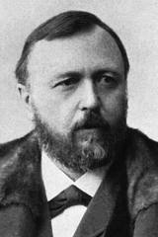
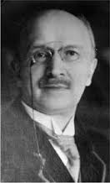
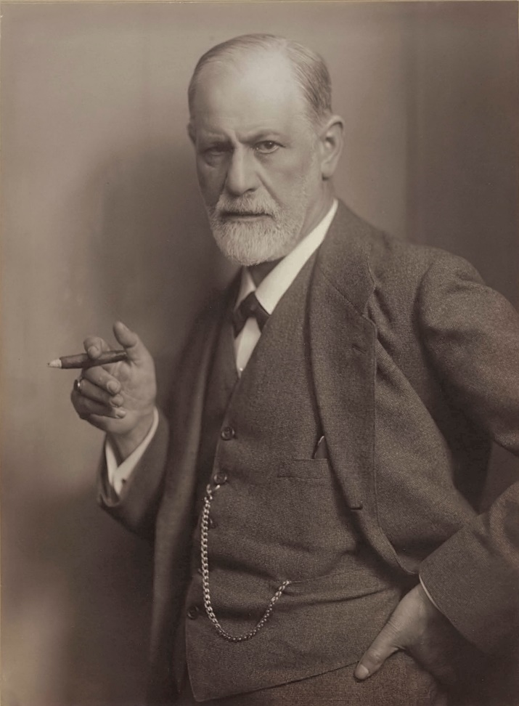
Focus assignment 9 → late 19th/early 20th-century ‘modernization’ of sexuality:
Epistemological and moral shift in Western tradition → new conceptualization and theories of sexuality in biomedical science and psychology, in particular by psychiatrists and neurologists:
Richard von Krafft-Ebing Albert Moll Sigmund Freud

Slide 12
Traditional experience of sexuality
Fixed in a prescriptive natural and moral order: Christian ethic of marriage, fertility and procreation: all deviations from norm considered as sin and crime, as undermining of social order → need for drastic restriction and control.
Functionally embedded in traditional collective social structures: sexual behaviour fully integrated in marriage, kinship, fixed gender roles, family-interests, social status and material/economic concerns.
personal sentiment and attraction of minor importance (‘falling in love’ = disordering ←→ moral and social requirements)

Slide 13
Modernization of sexuality
Sexuality object of science: 'sexual science' or 'sexology' carved out by psychiatrists and neurologists as a new professional field → Finding ‘truth’ about sexuality in body and mind and using such knowledge for setting ‘objective’ evaluative standards.
Moral-religious approach (virtue and sin; procreative norm) → biomedical and psychological approach (health and disease; normal and abnormal; socially acceptable and dangerous/destructive; constructive-destructive; responsible-irresponsible; consensual and abuse)
Broadening perspective and evaluation: in addition to procreation, acknowledgement of other functions/meanings of sexuality → discharge of physical tension for health and mental gratification; sexuality as essence of the self and self-realization; as relational force in connection with romantic love and marriage; significance of 'sublimated' sexuality for wider social relations and cultural achievements.
Ambivalence: considered crucial for love, relationships and companionate marriage, physical and mental health and wellbeing (‘sexual enthusiasm’; liberating and emancipatory potential), but also source of neurosis and other mental complaints, fears, anxieties, emotional pain and interpersonal tensions and conflicts. → Sigmund Freud

Slide 14
Sigmund Freud 1856 Freiberg (Moravia) – 1939 (London)
Middle class Jewish merchant family
1873-1881: medicine University of Vienna → Physiological and neurological research
1885: lecturer Medical Faculty in Vienna → 1902: Professor Extraordinarius
1885-1886/1889 Studies psychiatry/neurology in Paris and Nancy (hysteria, hypnosis)
1886: marriage
1886-1938: private practice as neurologist/psychotherapist (Berggasse 19, Vienna; Museum)
1902: first followers, 'Wednesday Night Meetings‘ → 1908: Vienna Psychoanalytic Society, Berlin Psychoanalytic Society, and First International Psychoanalytic Congress
1909: honorary degree Clark University (USA)
1910-1914: first conflicts within psychoanalytic movement (dissenters: Adler, Stekel, Jung)
1910: International Psychoanalytic Association, followed by national associations (American, 1911; British, 1913, Dutch, 1917 and 1933 etc.)
1919: international Psychoanalytic Publishing House
1920s and 1930s: growing public fame, followers all over the Western world and adoption of psychoanalysis in mental medicine, psychotherapy and cultural and sociopolitical analysis (including ‘Freudomarxism’ (Reich) → Frankfurter Schule (Horkheimer, Adorno, Fromm, Benjamin, Marcuse))
1923: diagnosis of cancer in jawbone
1930: Goethe Prize for prose (but no Nobel Prize for medicine as hoped for)
1938: Nazi-annexation of Austria → Freud into exile in London.
1939: Death

Slide 15
What is psychoanalysis?
More or less coherent (and changing) collection of theories and concepts about human beings as psychosomatic creatures, based on (scientific) claim of radically unbiased, uncompromising rational exploration of the human mind.
Scientific psychology? Freud and his followers: ‘yes!’ But disputed and nowadays considered as doubtful.
Cultural philosophy in terms of man's mental make-up.
Psychotherapeutic method for treating nervous/mental complaints: gaining access to the unconscious memory traces of repressed desires and bringing them to consciousness in order to make them manageable.
Organized movement: national and international associations and societies, conferences, journals, publishers, professional ethos, standards for orthodoxy and proper training.

Slide 16
Freud's self-image and view of man
Freud as disenchanting ‘archeologist of the mind’ shattering man's illusions about himself → revealing how man deceived himself through unconscious psychological mechanisms.
Believing in rationalist project of the Enlightenment but at the same time undermining Enlightened image of man as intrinsically reasonable, self-conscious and self-controlled. Freud: man = irrational being driven by anarchistic underworld of drives and impulses, and unconscious cravings and inner conflicts → man not transparent for himself and not his own master.
Freud’s claim of third historical undermining of self-proclaimed superiority and dignity of man, after Copernicus/Galileo (earth not center of universe) and Darwin (man part of nature; on the same level rather than far above animals).

Slide 17
Today’s dubious and controversial reputation of Freud: genius, heroic pioneer, revolutionary thinker or swindler, fabulist, cheat, charlatan, plagiarist and manipulator?
Weak empirical foundation; psychoanalysis so ambiguous and flexible that it cannot be scientifically tested and verified → speculative philosophy, pseudo-science; a set of beliefs, doctrines and rhetorical tactics and tricks rather than science? Theory creating its own facts?
Framing of case histories and clinical findings in order to fit theory - instead of empirically testing it.
No proof of effectiveness of (usually lengthy, intensive and expensive) therapy.
Propagating legend about himself: Freud having made himself greater than he was? → Disputed claims of originality and accusations of plagiarism; not paying tribute to the influence of other thinkers and character-assassination of opponents.
Organization of psychoanalytic movement as religious sect: Freud prophet with dedicated disciples guarding orthodoxy and demonizing and pathologizing deserters and opponents. (Those who don't believe in psychoanalysis have not yet overcome their 'inner resistance' against its fundamental truths.)
Male chauvinist pig? ‘Was will das Weib’? → ‘dark continent’; woman as failed man: ‘penis-envy’; ‘anatomy is destiny’.

Slide 18
Scientific (and ethical) credentials of Freud demystified, yet his influence on the psychological self-understanding of modern man has been formidable.
‘un­conscious’, ‘repression’, ‘resistance’, ‘sublimation’, ‘transference’, ‘dream-symbols’, ‘erotogenic zones’, ‘polymorphous perverse’, ‘pleasure principle’, ‘narcissism’, ‘Oedipus complex’, ‘fixations’, ‘oral, anal and genital phase’, ‘Freudian slips of the tongue or pen’
Modern man as psychological being: assumption of largely hidden intrapsychic domain of human life as seat of authentic ‘real’ self and source of emotional self-realization as well as anxieties.

Slide 19
Freud/Josef Breuer, Studien über Hysterie (1895) Studies about Hysteria
Causes of hysteria and other nervous disturbances can be found in childhood experiences and repressed sexual trauma's (seduction theory: sexual abuse by adults) or repressed (infantile/perverse) sexual desires and fantasies
importance of (unconscious; disguised) memory-traces and imagination in development and dynamics of psychic and sexual life.

Slide 20
Die Traumdeutung (1900) The Interpretation of Dreams
Meaningfulness of dreams (partly based on self-analysis):
Giving access to the unconscious, repository of disconcerting yearnings conflicting with social propriety and feelings of shame and disgust.
Disguised fulfillments of censored/repressed (often sexual or aggressive) wishes and desires.
Referring back to formative childhood experiences and persistent infantile desires.
Puzzles with own weird logic → dream images are symbolic and have to be decoded (on the couch with the help of the analyst).
Apart from dreams , also (‘Freudian’) slips of the tongue and pen, and jokes revealing something about unconscious and repressed yearnings.
Zur Psychopathologie des Alltagslebens (1901) The Psychopathology of Everyday Life
Der Witz und seine Beziehung zum Unbewussten (1905) Jokes and Their Relation to the Unconscious

Slide 21
Drei Abhandlungen zur Sexualtheorie (1905) Three Essays on the Theory of Sexuality
Sources of sexual drive: childhood and largely hidden intrapsychic life → child driven by boundless and direct pleasure-seeking and lustful satisfaction → 'polymorphic perverse‘ infantile sexuality: undetermined, undifferentiated, fluctuating and fragmented mishmash of impulses → no distinction between 'normal' (hetero)sexuality and 'abnormal' perversions (narcissistic 'auto-eroticism', homosexuality, fetishism, sadomasochism, voyeurism, exhibitionism, anal and oral fixations and on other 'erogenous zones' of the body).
Sexual desire not given by nature but shaped in (conflictual) psychological processes: how the mind processes experiences of the body and its impulses and how these experiences are captured in unconscious memory-traces, imagination, fantasies, dreams, hidden motives, perceptions, associations, feelings, emotional attachments, character features, anxieties and obsessions.
Regular (hetero)sexuality not naturally given but result of a vulnerable developmental conversion of polymorphous sexuality into object-related and aimful desire → Puberty/adolescence (dealing with Oedipus-complex) decisive phase towards delineated object choice, genital sexual activity, embedded in love relationship.

Slide 22
Die 'kulturelle' Sexualmoral und die moderne Nervosität (1908) Modern Sexual Morality and Modern Nervousness
Criticism of Christian-bourgeois culture:
Excessive repression of sexual desire in Western middle-class culture and Christian morality detrimental to people’s health and wellbeing: lack of sexual gratification leading to neurotic disorders.
Modern civilization inhibiting aspects of sexuality that do not undermine culture and that are vital for sustaining physical and mental health and for constructive sublimation of sexual energy serving cultural purposes.

Slide 23
Totem und Tabu: Über einige Übereinstimmungen im Seelenleben der Wilden und Neurotiker (1913) Totem and Taboo: About some Similarities in the Psychic Life of Savages and Neurotics
Speculative theory about origin of civilization and morality → 'primal scene': sons killing their despotic father who monopolized access to women → guilty conscience → worshipping memory of father → origin of religion (totem), incest-taboo → morality and sociability.
Oedipus-complex: children’s first object of sexual desire mother (boy: father rival who has to be removed) or father (girl).
Fear of father’s wrath: castration-anxiety.
‘Solution’: shifting sexual desire to another woman (outside of the family) and identifying with father → male gender identity and heterosexual orientation (wanting to have mother → wanting to be like father).

Slide 24
Jenseits des Lustprinzips (1920) Beyond the Pleasure Principle
Introduction of Thanatos (death instinct: longing for a return to state of non-activity) as existing side by side with Eros (life-preserving energy).
Freud’s thinking increasingly pessimistic.

Slide 25
Das Ich und das Es (1923) The Ego and the Id
Freud's topography of the mind: complex, dynamic, multi-layered and largely hidden battlefield of antagonistic drives, impulses, memories, fantasies, yearnings and feelings.
SUPER-EGO (ÜBER-ICH)
(moral/cultural censor: 'forbidden', 'wrong', 'thou shalt not', 'shame on you')
Pressure: fear, shame, anxiety, guilt
(beleaguered) EGO (ICH)
(conscious self: self-awareness, self-preservation, self-control, deliberation)
Pressure
Pressure →Evading mental tactics:
irresistible excitation resistance
wish-fulfillment inhibition UNCONSCIOUS
pushing energy repression displacement
tension and discharge defenses ID (ES)
Eros (life, pleasure/lust)←→Thanatos (aggression/hate/destruction/death)

Slide 26
Die Zukunft einer Illusion (1927) The Future of An Illusion
Freud the ‘infidel Jew’ (convinced atheist):
Uncompromising demystification of religion as collective neurosis or childish illusion → religion as fairy-tale wishful thinking and unrealistic evasion from facing harsh realities of life (no purpose, inevitable helplessness, suffering and death).

Slide 27
Das Unbehagen in der Kultur (1930) Civilisation and Its Discontents
Irresolvable tension in human life:
Need to suppress instinctual urges (sex and aggression) for sake of peace and civilized life; need for moral structures and social institutions as barriers against rape, incest, violence and murder.
Compulsive instinctual drives pushing persistently and relentlessly, defying willpower and rational and moral consideration → cultural barriers and prohibitions cause anxieties, mental and neurotic complaints, (sexual) frustration, unhappiness: 'we are all neurotics' → the 'discontents' of civilization (cf. Weber's 'iron cage' in rationalized society).
Freud’s pessimism: stable balance between civilized security/comfort and gratification of basic passions and urges out of reach → man as torn being: captured in unending struggle between unruly passions and need to tame them. (‘We may perhaps be forced to become reconciled to the idea that it is quite impossible to adjust the claims of sexual instinct to the demands of civilization.’ (1912)) → cf. Weber’s warring Gods and demons.

