Slide 1
Narrative in the Human Sciences
Harry Oosterhuis

Slide 2
Narrative ←→ logical-analytical discourse
Discourse: a patterned way of talking and writing in which the use of certain terms, concepts definitions and assumptions in combination and particular styles of reasoning, argumentation and association produce a certain coherence and a specific meaning, and in science a truth-claim. An integration of words and sentences that conveys a covering meaning that is more than the meanings of separate words, sentences and pieces of information.
Logical-analytical discourse: explaining by abstraction and formal logic; structured in a standardized and predicable way; impersonal, objectifying, matter-of-fact and detached style.
Narrative: storied discourse, either fictional or non-fictional.

Slide 3
Narrative in cultural studies and the humanities
Narratives as object of cultural studies and the humanities: the meanings which people give to their existence are often articulated in stories about the lives, experiences, events and conditions in which they are involved.
Narrative accounts as the textual form in which cultural scholars (and social scientists) report on their research.
Narrative as a legitimate cognitive and discursive form next to the established logical-analytical form of discourse in the natural and (quantitative) social sciences.

Slide 4
Basic features of narrative
holistic (meaning in context)
retrospective and teleological
human experience in time
moral dimension

Slide 5
1. A holistic and meaningful representation of human experience
Understand in terms of meaning and human purpose → storyline, plot, scenario, script referring to motivated actions.
The meaning of the story as a whole is more than the sum of the meaning of the parts.
Meaningful connections between sentences or statements by integrating them in a plot that connects a beginning with a purpose and an end or closure.
Narrative bestows unity, continuity and meaning in an order of events.
Dialectical relation between the whole and the parts: the parts selected, grouped and organised from the perspective of the plot-line of the story; discursive structuring that continuously moves back and forth from singular events and actions to the central theme or design of the narrative.
Singular events and actions are integrated in the same order of meaning and therefore in a coherent whole, linking the explanation of how things happen with making clear why they happen.
The plot weaves together a complex of selected events and actions in a storyline with a beginning, a middle and an end (closure and resolution).
Narrative understanding is not analytical but holistic: it is the comprehension of a complex of events by seeing the whole in which the parts participate; seeing-things-together in the light of a plot, which implies purposes and values.
A story explains, not on the basis of logical arguments, but by showing the meaningful pattern in what has happened.
Narratives are embedded in culture and can only be understood through interpretation or the hermeneutic method.
Story-plots can be understood because they are recognised in terms of the cultural repertoire of stories we are already familiar with.

Slide 6
Paleoanthropological stories about the evolution of man
For example: how in paleo-anthropology the evolution of mankind has been clarified in the form of stories with typical episodes and plots, which share some formal features with fairy-tales. In her dissertation Narratives of Evolution (1993) the American historian of science Misia Landau has demonstrated that the way in which some prominent American and British scientists have presented their interpretative reconstructions of early human evolution in particular stories. These stories are structured on the basis of crucial phases (fundamental changes, innovations, inventions) and themes which are similar to other stories such as fairy-tales, folk-tales, myths and heroic epics.
In general paleoanthropologists have recognized four main episodes in human evolution:
a shift from the trees to the ground (terrestriality);
the development of upright posture (bipedalism);
the development of intelligence and language (encephalization);
the development of technology, morals and society (civilization).
However, the significance of these episodes is interpreted in various ways by paleoanthropologists as a consequence of the different sequencing of these episodes in their stories, which involves different plot lines.

Slide 7
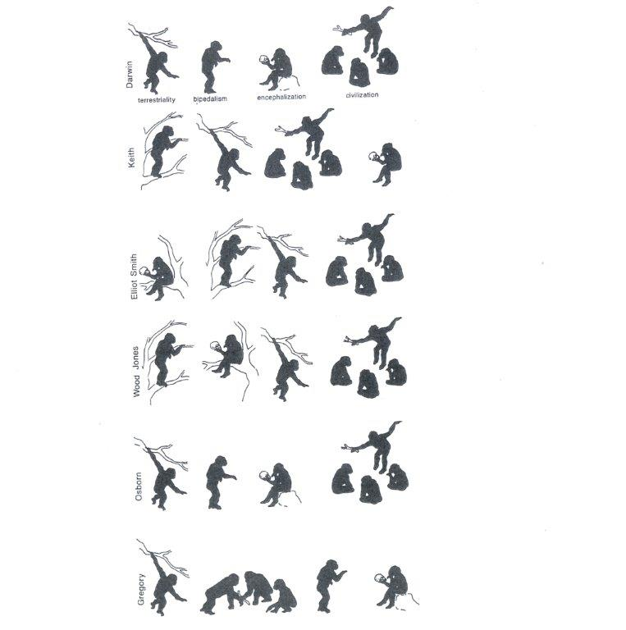
Different narratives about the main stages in human evolution: terrestriality, bipedalism, encephalization, civilization

Slide 8
Early human evolution as a heroic epic
The four stages are related to each other through a narrative plot about a ‘hero’ in which nine prototypical themes or functions can be distinguished:
An initial situation which is presented as a state of equilibrium in which the predecessors of mankind lead a relatively safe, stable and untroubled existence, usually in the trees like other primates such as apes and monkeys.
The introduction of the ‘hero’ who is smaller and weaker than other animals, but who will overcome his humble origins and vulnerability (a common feature of heroes in myths and folkloristic narratives).
The dislodging of the hero from his habitat by either compulsion or by choice, as a consequence of either a changing living-environment or of a change in the hero (the acquisition of a larger brain or of an upright posture).
The departure, the beginning of a journey or adventure as a turning-point: the escape from the established existence and the move towards a new existence.
The test, the facing of a series of challenges in the new, unknown situation and the dealing with a series of tests in order to survive. The successful passing of such tests entails the enhancement of the hero (for example growing intelligence and better mobility as a consequence of his upright position) and the beginning of man as a being who can take his fate in his own hands.
This self-making is made possible by the donor, a beneficent force, which is often a nonphysical one: the power of thinking and intelligence. (In fairy-tales and folktale the donor is often a magical agent or object: a cloak, sword or a ring.)
Transformation: the power of thinking and intelligence which provides man with plasticity, initiative, the ingenuity to make tools, and which makes him unique among other animals.
New tests: the struggle with new environmental challenges which are now faced with the help of the new capacities and which stimulate their further development and improvement.
Final triumph: the rise of social bonds and civilisation, which make man less dependent on the whims of nature and which set the preconditions for the emergence of modern man. The outcome is human victory in the struggle with nature.

Slide 9
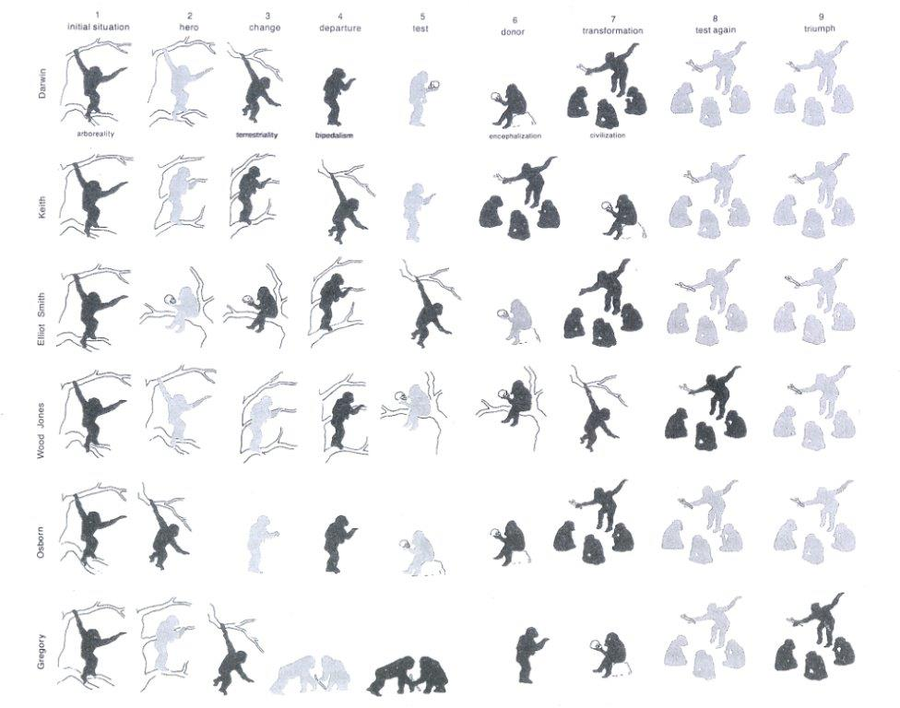
That paleoanthropologists have come up with different interpretations and explanations of the early evolution of man is an effect of the differences in how these episodes and themes are ordered in a certain sequence, related to each other and organized in narrative plots.

Slide 10
2. The retrospective and teleological character of narrative
Narrative is about unique and unpredictable series of human actions and events in a particular context.
Narratives generate their covering meaning through the arranging and sequencing of events and actions in such a way that the connection between them becomes significant and comprehensible in terms of direction and purpose (which are not known beforehand but only after actions and events have reached a closure).
The events and actions can only be given their relevant place in a narrative order retrospectively. Earlier events and actions are described from the perspective of their meaning for later ones and eventually on the basis for their contribution to the outcome of the story.
Stories can only be told after events and actions have happened and have come to a closure, when it is possible to oversee and show the interconnection between how and why they have happened.

Slide 11
3. Narrative is about change in time
Narrative organized on the basis of the human experience of change in time.
Experience in time is organized in meaningful units and it orients change by investing it with purpose. Or: the meaningful human experience of time often takes on a narrative structure.
The human experience of time: awareness of a continuity between the past and the present on the basis of the memory of a series of events, happenings and experiences that stand out.
Looking towards the future in the form of anticipation: expectations, hopes, desires, fears; optimism or pessimism of what the future will bring.
Narrative makes the past and the future meaningful from the perspective of the present.
In order to be part of meaningful temporal order, an event, action or experience must be related in a meaningful way to other events, actions and experiences that have preceded it or will come after it.

Slide 12
4. The moral dimension of narrative
Stories involve human action that is motivated and oriented towards values and purposes.
Organizing the presentation of selected events and actions in temporally meaningful episodes and relating them to each other in such a way that they are relevant in the light of a certain outcome: a closure which is often about the fulfilment or failure of human desires, goals and purposes and which implies an implicit or explicit moral meaning or judgment.
Narratives often carry cultural values about what to do, what to strive for, about purpose in human life, and also about what should have happened or what has gone wrong. They may provide (positive and negative) models of action.

Slide 13
Moral closures in evolutionary narratives
Heroic epic → Suggestion of hope: the symbolic victory of human civilisation over nature. For example, Darwin in his The Descent of Man:
  Man may be excused for feeling some pride at having risen, though not through his own exertions, to the very summit of the organic scale; and the fact of having thus risen, instead of having been aboriginally placed there, may give him hope for a still higher destiny in the distant future.
Heroic drama → Pessimistic vision: the suggestion of uncertainty and possible destruction as a consequence of hubris → For example, T.H. Huxley (1889):
  I know no study which is so utterly saddening as that of the evolution of humanity. Man emerges with the marks of his lowly origin strong upon him. He is a brute, only more intelligent than the other brutes, a blind prey to impulses, which as often as not lead him to destruction; a victim to endless illusions, which make his mental existence a terror and a burden, and fill his physical life with barren toil and battle.

Slide 14
Story-telling as the human mode of finding orientation and giving meaning to existence
Growing attention for and interest in narrative in the human sciences: the knowledge tools of the human sciences have to be geared or should reflect the particular characteristics of human existence as it is lived, experienced, interpreted, and given meaning in ordinary life.
Narrative as a crucial form of human cognition and expression through which events and experiences can be endowed with coherence and direction, structure, continuity and purpose.
Cognitive psychology: narrative competence (the capacity to understand and tell stories) is a fundamental part of human thinking, in particular with regard to finding orientation in a chaotic and confusing world.
Paul Ricoeur (phenomenology): narrative capacity is fundamental for understanding other people’s behaviour and motives as meaningful and purposeful in the wider context of other acts, events and social actors. The meaning of separate acts and behaviours can only be understood as part of the (implicit) story in which they are embedded; the understanding of acts and behaviours is similar to the interpretation of a story.

Slide 15
The narrative formation of self-understanding and personal identity
Narrative plays a central role in autobiographical self-understanding and the formation and continuation of personal identity. Some sort of continuity between the past, present and future is a necessary precondition for a life with direction and purpose, and having an identity (the awareness of being the same person through time and in different situations). People need some sort of coherent understanding about themselves in order to have a basic sense of identity. This coherence can be found in their implicit or explicit ability to tell a continuous and unfolding story about the course of their lives. Each person has a unique set of memories about his or her past life, which is linked to present experiences, and each individual is, in principle, capable of telling a unique story about the development of his or her life - a story that connects those memories with the present condition and experiences as well as with expectations or goals for the future.
Autobiographical self-understanding is based on a retrospective selection and ordering, and also frequent reordering and interpretive revising, of events and experiences in one’s past life in such a way as to create a self-narrative that is coherent and more or less satisfying in the sense that it is in line with, makes sense of and justifies one’s present condition and situation. It is a form of appropriation of the past in the interest not only of the present, but also of anticipating the future: autobiographical narrative links up the personal past, the present condition and the anticipation of the future. The experience of self is organised along the temporal dimension in the same manner that the events of a narrative are organised by a plot in a coherent story. In autobiographical self-understanding life events, acts and motivations are linked in such a way that they bestow existential continuity on the experience of the self. We make (or try to make) our life into a meaningful whole by understanding it as if is an unfolding and developing story. We are in the middle of our particular life-stories and cannot be sure how they will end. Fundamental new experiences and events may entail the need to adapt or revise the plot in our life-stories. The self, therefore, is not a static substance, but a dynamic configuration in a narrative framework, which includes not only what one is or has been, but also anticipations what one will be or would like to be in the future.

Slide 16
Autobiography as self-narrative
We can see the narrative dimension of self-identity clearly in autobiographies. Autobiographers make clear what sort of person they are or have become by indicating which particular situations, events and experiences in their lives had special significance and were formative for their personality. These events and experiences are framed in their story in such a way that some sort of unity, development, direction and purpose is established in their life-course. Autobiographers often relate the story of their life as a continu­ous process with an inner logic leading up to what they have become and what they have (or have not) fulfilled. In this way, personal narratives are not merely descriptive, but they also explore, explain and justify the self. Interpre­ting past events from a present point of view and anticipating the future course of their lives, they narrate their lives in terms of a basic plot formula or story-pattern that are often borrowed from genres and tropes or metaphors in the wider culture: the life-story as a tragedy, heroic epic, melodrama or romantic saga; the life-course as Bildung-process, as a struggle, as journey, as a voyage of discovery or explorative expedition; life pivoting upon the discovery of a vocation or destiny, a radical conversion, the discovery or confession of a secret, the suffering and coping with a trauma, the fulfilment of (or failure to realize) one’s desires, ambitions, or moral purpose, or the quest for and the finding back of a lost paradise (coming home again).

Slide 17
Narrative in psychology, psychiatry, psychotherapy and medicine
Psychological and sociological research of life-stories: analysing and understanding individual life courses and the way people experience their own lives, in particular with regard to the restrictions and possibilities against the background of their social situation and position in society.
Psychoanalysis, psychiatry and psychotherapy: reconstructing the continuity of a life-story that has disrupted; the effort to change the life-story in a form that fits the present condition of the patient or client better than his or her former life story.
Medicine: critical counter-balance to medicine as natural science and technology and advancing the human face of medicine, not only as cure but also as care → more attention for patients’ experiences and voices as these are articulated in their personal stories about the course of their illnesses, throwing light on the wider meanings of illness.
Personal narrative in the practice of medicine, psychology, psychiatry articulate the viewpoints and voices of patients and clients, their personal, subjective experiences: inner thoughts, motives and feelings, aspects of reality that cannot be expressed by purely scientific, logical and analytical discourse.
Relevant for the practice of the helping professions themselves as well as for sociologists and historians of these fields: valuable sources about the experiences of patients and clients and their interactions with professionals.

Slide 18
Readings about narrative in the human sciences:
Polkinghorne, D.E. (1988). Narrative Knowing and the Human Sciences. Albany: State University of New York Press.
Hinchman L.P. & S.K. Hinchman (Eds.) (1997). Memory, Identity, Community. The Idea of Narrative in the Human Sciences. Albany: State University of New York Press.

