Slide 1
Alexis de Tocqueville:
(1805-1859) pioneer political thinker
Social-historical explanation of democracy instead of idealistic/philosophical perspective.
Showing problems, dilemmas and dangers of democracy, which are still relevant today.

Slide 2
Impact of personal background and life
Born in 1805, under Napoleon’s regime in noble family, after French Revolution (1789-1799) → Relatives involved and executed during ‘Reign of Terror’ (1793-1794).
Studied law and employed at court of law in Versailles.
1831-1832: touring United States in order to investigate American prison systems for French government → more interested in American democracy (at that time most advanced one in the world) → seminal work De la démocratie en Amérique (Democracy in America, 1835/1840): descriptive analysis of conditions and working of democracy, positive and negative features.
Active in French politics as member of the parliament (1839) and briefly as minister of Foreign Affairs (1848).
Second major work: The Old Regime and the French Revolution (1856).

Slide 3
Tocqueville’s preoccupations
Interest in democracy inspired by French Revolution (having deeply affected his family) and his travels in United States → Basic question: American democracy as a model for Europe in general and for France in particular?
Aristocratic background: attached to historical tradition and continuity, but at the same time awareness of inevitability of democracy, including advantages and disadvantages.
Inspired by:
liberal values: protecting individual liberty against state through the rule of law
conservative leanings: importance of self-control, social obligations, cohesion/community-spirit, cultural traditions and religion
republican element: the need for active citizenship

Slide 4
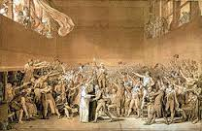
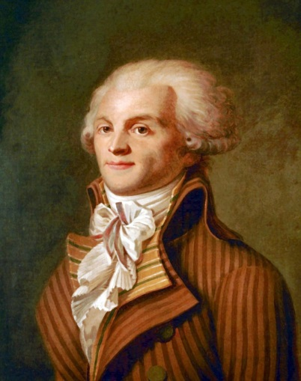
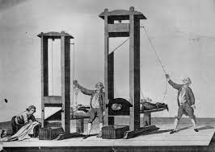
Tocqueville haunted by spectre of French Revolution
Breakthrough of liberal democracy and modern citizenship in Europe (preceded by American War of Independence), but … many heads chopped off in the process and chaos, fanaticism, violence, terror and dictatorship.
Moderate liberal phase Radical Jacobin phase following
(1789-92) Rousseau’s democratic model (1792-95)
Liberal priority of individual Republican priority of
self-determination collective self-determination

Slide 5
Downside of French Revolution
Promising start (liberty, equality, fraternity) but destructive revolutionary dynamics:
Democracy degenerating into extremism, violent conflict, civil war, (state) terror and dictatorship.
Political involvement of popular masses → fanaticism, black and white thinking, demagogy, manipulation and scapegoating → populism undermining basic democratic values.
Difficulty to establish stable democracy from scratch:
Democratic mentalities and attitudes not yet firmly rooted in French society: no respect and toleration of minorities and alternative views.
Lack of experience with institutional procedures and routines required to make liberal democracy workable: guaranteeing the rule of law, reasonable and peaceful discussion and compromise through parliamentary procedures.

Slide 6


What is democracy in Tocqueville’s view?
Two dimensions
‘Democratisation’ as an inevitable long-term social development in Western history (The Old Regime and the French Revolution, 1856).
Democracy as a political arrangement and its social conditions (Democracy in America,1835/1840).
→ Realisation of the first necessary precondition for realisation of the second.

Slide 7
Democratisation as long-term social development since Middle Ages
Traditional aristocratic social order in which individuals are imbedded in collective bonds of family, clan, tribe, feudalism, corporations, and village communities, and they are subordinated to hierarchical ranks and orders based on fixed status and privileges as well as religious authorities.
Social democratization (as consequence of socioeconomic modernization): gradual emergence of a diversified, literate, commercial and industrial society providing options for individuals to break away from traditional hierarchical and collective structures and to gain freedom of movement and initiative → levelling and equalization of individual social and economic conditions and opportunities with a homogenizing effect (differences of degree between individuals rather than fixed and of kind).

Slide 8
Social democratization paralleled by growing power of central state
In traditional settings political power widely dispersed in collective and hierarchical structures, locally/regionally in families, villages, parishes and feudal estates. Weak state sharing power with local/regional authorities (fathers, clergymen, noble lords, gentry, patricians and notables).
Traditional power structures eroding through social democratization, enabling more and more people to detach themselves from hierarchies and local communities and to become more or less free-floating individuals moving around within wider borders.
Political power moving from local settings to the state, where rulers (in France the absolutist kings and later revolutionary/republican governments: absolutist monarchy paving the way for revolution) strive for centralisation and national unification.

Slide 9
Tocqueville: tension between individual and collective self-determination → two threats to democracy
On the one hand (liberal perspective): power of centralised (either authoritarian or democratic) state threatens individual liberty, in particular if counterbalancing forces (traditionally collectivist/corporative structures and in modern conditions robust civil society through which citizens organize themselves) are lacking in society. (During French Revolution: no counter-balance against centralized state and ‘democratic despotism’. )
On the other hand (republican perspective): individualisation (social atomisation) as a threat for democratic involvement → if self-interested and self-satisfied individuals retreat in private sphere or economic pursuits and do not engage with the public good, rulers (democratically elected or not) will decide for citizens and will seize more and more power.
.

Slide 10
Tocqueville’s sociological perspective on democracy
He hardly discusses abstract democratic principles and institutions → democracy is more than a legal structure for guaranteeing rights and duties, and system for political debate and decision-making.
Focus on informal social conditions of democracy as precondition for political democracy: social attitudes, manners and morals, public morality, ethical values, freedom and civic virtue as practiced in daily life and local self-government; the importance of religion as overarching ideology, Christianity (with its basic equalizing thrust) encouraging moral restraint, altruism, dedication to supra-individual pursuits altruism.

Slide 11
Democratic way of life: commitment to particular values and attitudes
Non-violence: resolving conflicts through debate, reasonable and well-informed arguments, moderation and compromise, balancing different interests and taking into account wider consequences of decisions for everybody. → Democracy = ongoing debate without final conclusions.
Respect and tolerance for individuals and groups who are not like yourself, with whom you disagree, whom you may abhor. → Democracy = accepting difference and ‘otherness’.
Sense of solidarity with others/community-spirit; being informed and willingness to respect other voices and ways of life. → Democracy = social involvement and responsibility.

Slide 12
Undemocratic attitudes
Black and white thinking (‘us’ against ‘them’/ ‘friends’ and ‘enemies’/ seeing others by definition as a threat).
Notion of democracy as will of majority or supposedly undivided, uniform ‘will of the people’, thereby overruling rights of individuals and minorities.
Refusal to reconsider (majority) decisions taken. → Democracy = putting things in perspective and deal with imperfectness and provisional arrangements; being open for continuous debate and revision.

Slide 13
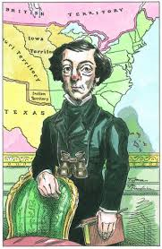
American example: historical and social/religious background
            Traditional obstacles hampering development of democracy in Europe largely lacking in USA:
    New, rather empty continent largely populated by immigrants: enterprising individuals building their own lives, many of them strongminded protestant dissenters (Puritans, Calvinists) escaping authority of established churches and traditional rulers.
    No established monarchy/aristocracy/feudalism/Church hierarchy → more equality of (economic, social and educational) opportunities and geographical and social mobility than in Europe.
    American society and (protestant/puritan) religious life intrinsically more individualistic and egalitarian than European societies and Catholic Church. (Fate of Indian and black population in America, however, different story.)

Slide 14
American democracy
Inbuilt checks and balances in order to contain power of central state and to prevent ‘democratic despotism’:
Division of political power (Montesquieu’s Trias politica):
- executive (President)
- legislative (Congress: Senate and House of Representatives)
- constitutional (Supreme Court and other courts of law).
Federalism: government on federal, state and local level (many people directly involved in local government).
State power ←→ robust and pluralist civil society (including local Church communities) on the basis of social engagement and voluntary social associations out of well-understood self-interest (acting in the interest of others will ultimately also serve one’s own interest).

Slide 15
Tocqueville’s insights still relevant for today
Danger of populism (‘tyranny of the majority’) and authoritarian leaders arising under democratic conditions.
Democracy not only about rights and liberties but also requiring social obligations and responsibilities.
Importance of active social and political involvement and social cohesion/robust civil society as counterbalance to state-power.
Ambivalent relation between democracy and capitalism.

Slide 16
Danger of populism
Leveling tendencies of social democratisation may lead to social and cultural homogeneity and a uniform public opinion → democracy degenerating into demagogy and ‘tyranny of the majority’ or ‘democratic despotism’.
Need for diversity and pluralism, protection of minorities, checks and balances.

Slide 17
Democracy requiring active and responsible citizenship
Not only individual rights and liberties, but also social responsibilities, duties and obligations.
Peaceful and stable democracy can only be realized if freedom is balanced by self-control and responsible attitude: being informed; thinking before speaking; listening to others and respecting them; self-criticism; moderation; willingness to compromise; and constant vigilance with regard to constitutional and democratic principles.
Wide-spread (populist) tendency nowadays to equate democracy with (presumed) will of majority as well as unlimited freedom to do and say (or shout and twitter) as one pleases; the right to this and that without bothering about other people and common good.

Slide 18
Civil society ←→ social atomization
Robust civil society (citizens organizing themselves in all kinds of associations and participating in public life) crucial for vigorous democracy requiring social cohesion and community-spirit.
Unrestrained individualism and social atomization combined with social and political apathy can jeopardize democratic involvement and lead to all-powerful state.

Slide 19
Ambivalent relation between democracy and capitalism
On the one hand, capitalism as economic trigger of social democratization: free market (enterprise, trade, industriousness, social mobility) advanced dissociation of individuals from traditional hierarchical and communal forms of existence and thus furthered equality of opportunity.
On the other hand:
Capitalism bringing about preoccupation with economic self-interest, private wealth and consumption → self-satisfied individuals not caring for public good and withdrawing from social and political involvement → undermining of democracy.
Free-market capitalism entailing increasing socio-economic inequalities and contradicting formal democratic norm of equality (equal rights and equality of opportunity) → frustration, envy and resentfulness → populism.

